Slide 1



Corruption Perceptions and Experience Poll

Slide 2
Perception and Experience of Corruption

Slide 3
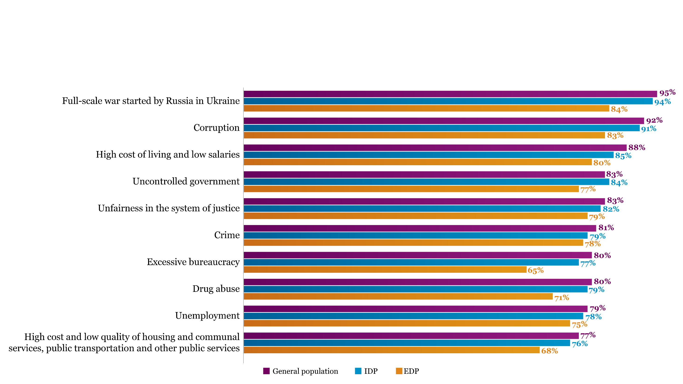
Q. How serious are the following problems in Ukraine today? (sum of responses “serious” and “very serious”)
Corruption Ranks Among the Top-2 Concerns After the Full-Scale Invasion

Slide 4
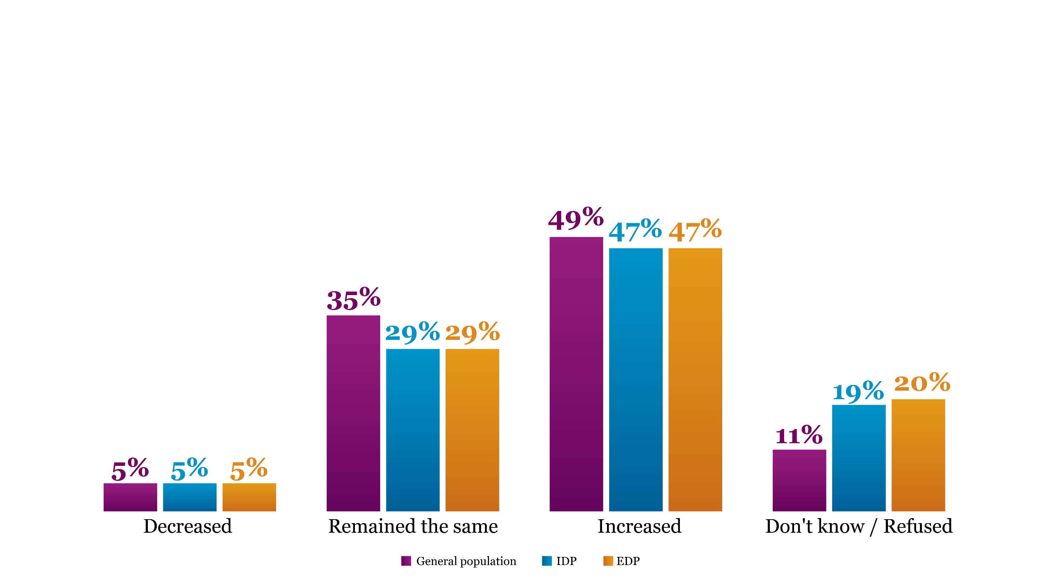
Q: Do you think the level of corruption has changed in Ukraine over the past 12 month?
Perceptions of Corruption Trends Vary Among Ukrainians

Slide 5
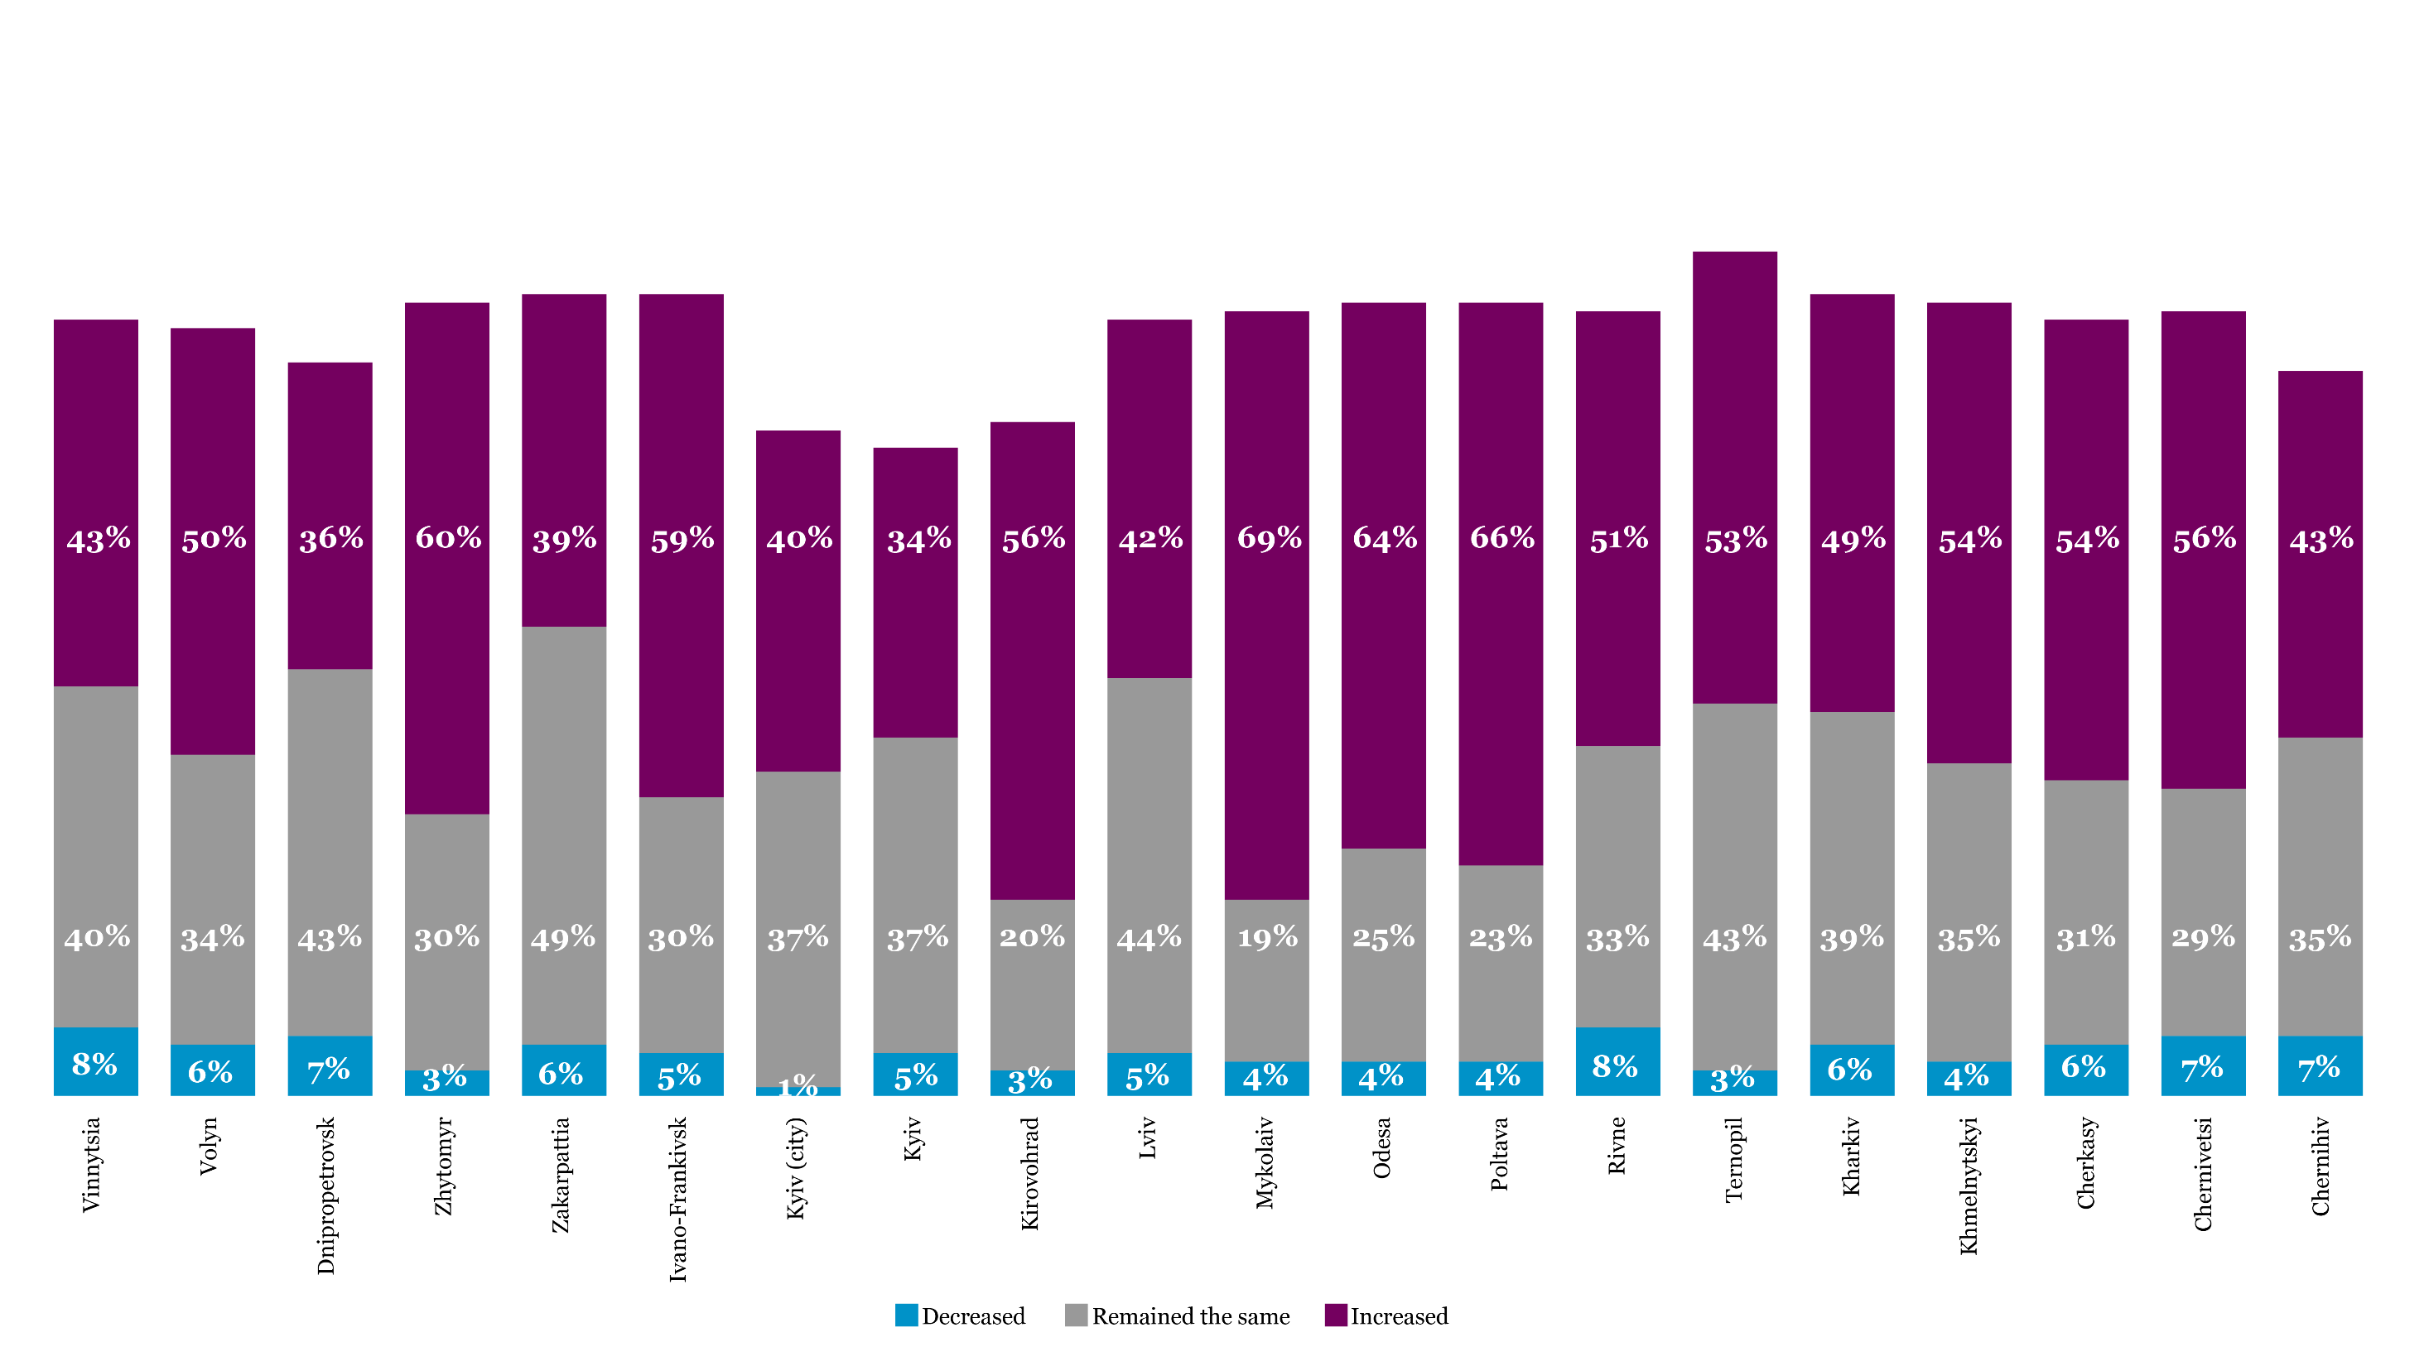
Mykolaiv, Poltava, and Odesa Oblasts Rank Highest in Perceived Corruption
Q: Do you think the level of corruption has changed in Ukraine in the past 12 months?

Slide 6
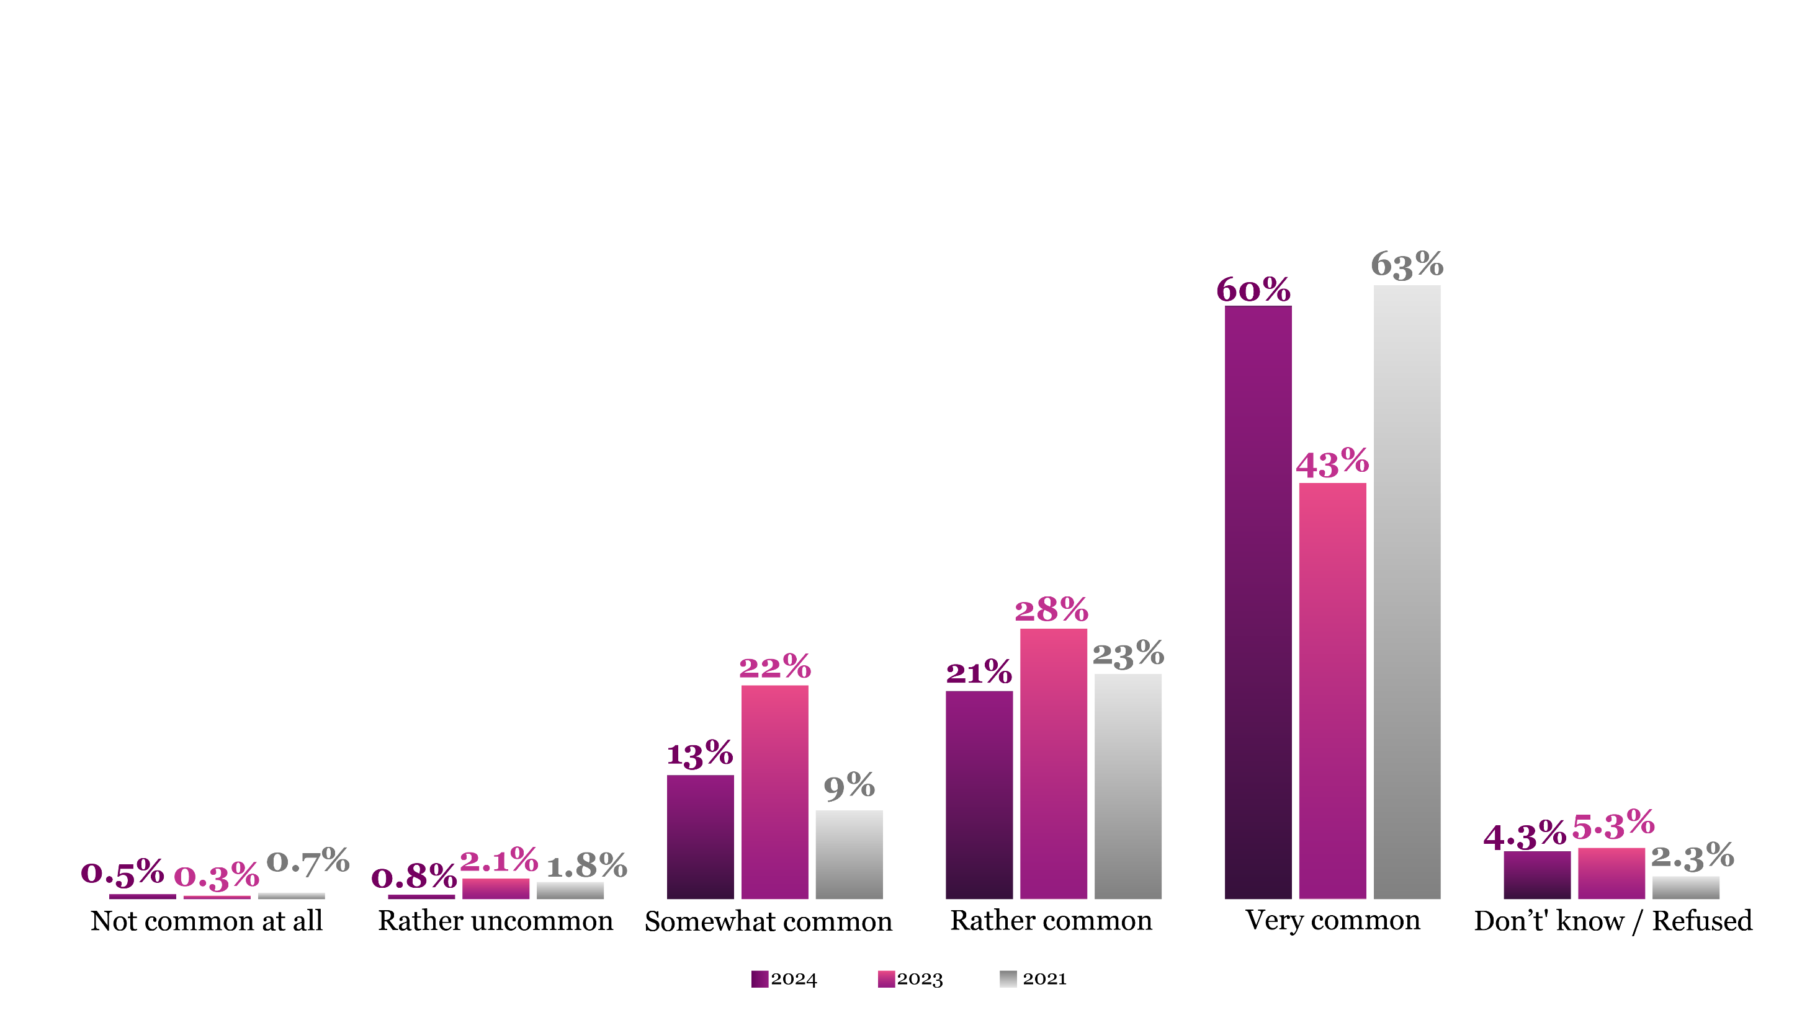
Q: In your opinion, how common is corruption in Ukraine?
Perceptions of Corruption as a Common Issue Remain High

Slide 7
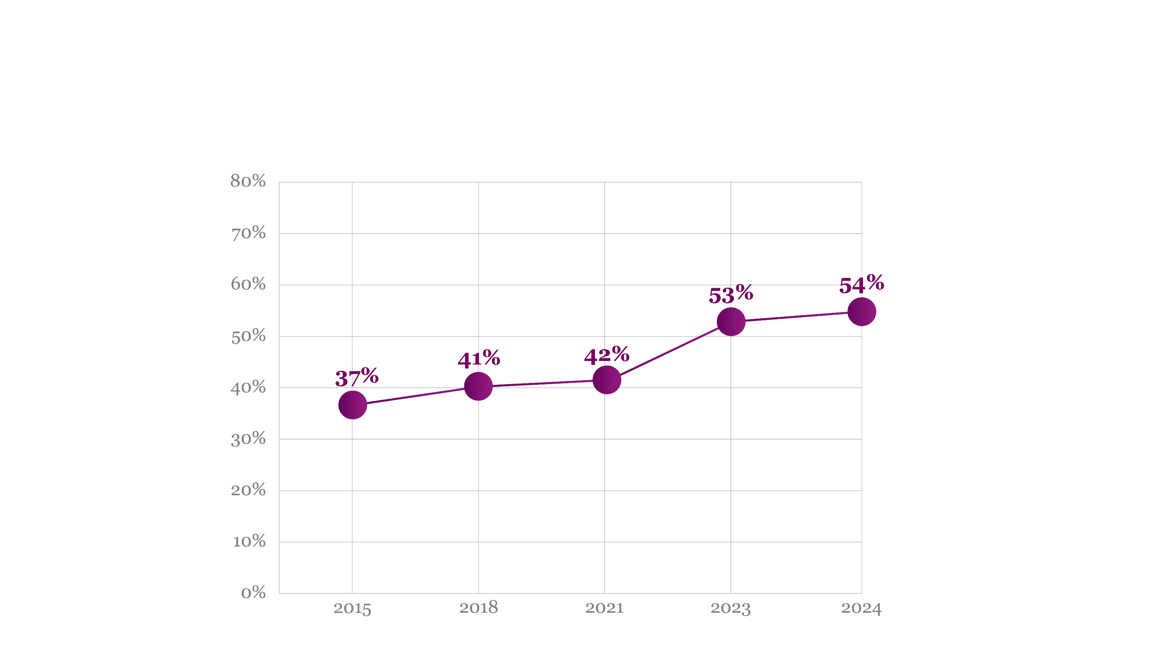
Q: Do you believe that giving bribes, unofficial services, or gifts can be considered justifiable when it becomes necessary to resolve a problem that holds significant importance to you? — Never justified
Increasing Intolerance Towards Bribery Among Citizens

Slide 8
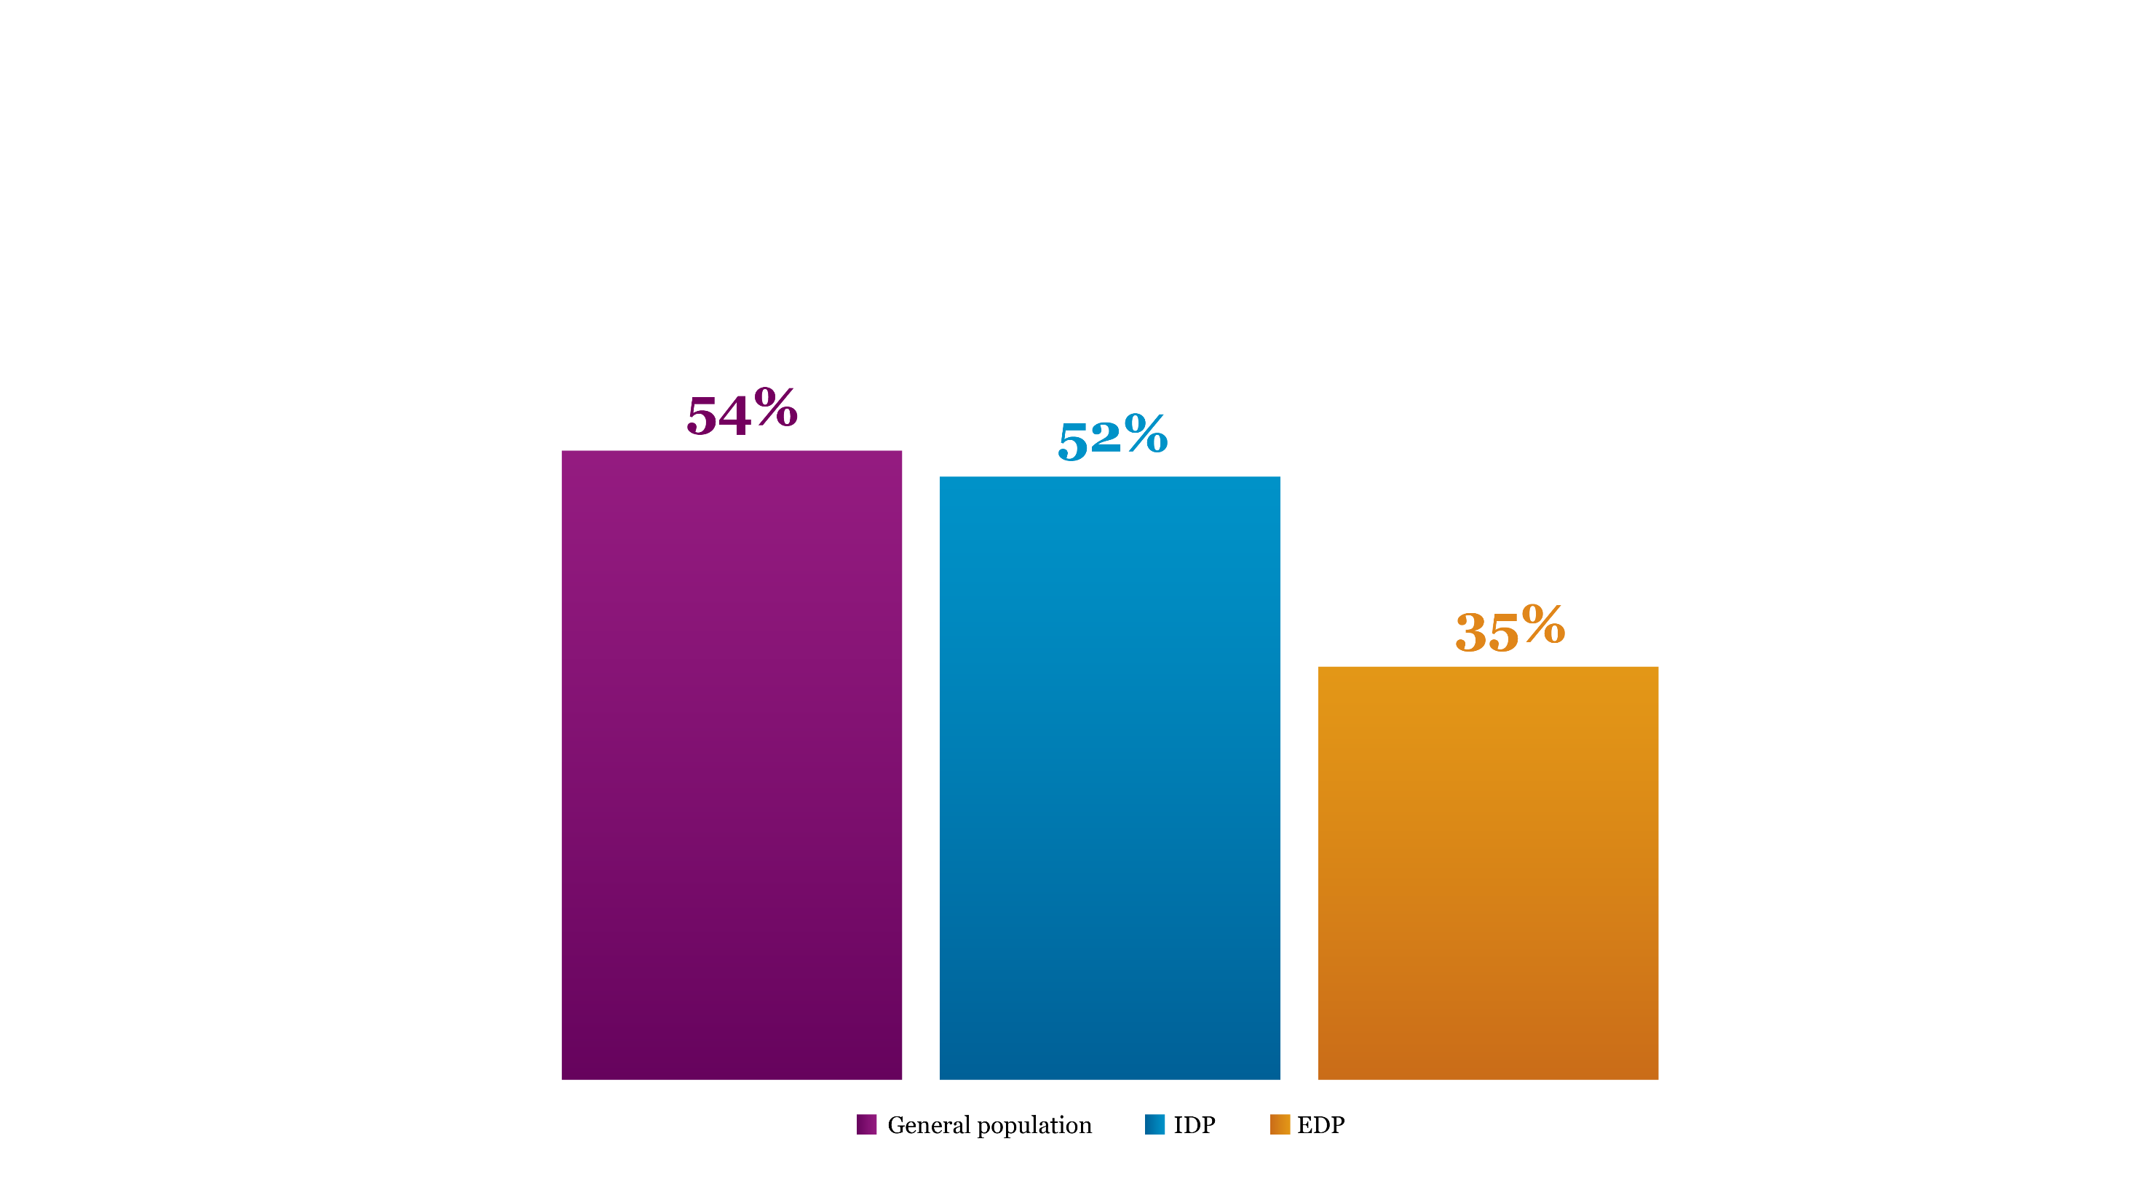
Q: Do you believe that giving bribes, unofficial services, or gifts can be considered justifiable when it becomes necessary to resolve a problem that holds significant importance to you? — Never justified
EDPs Show the Greatest Tolerance for Bribery

Slide 9
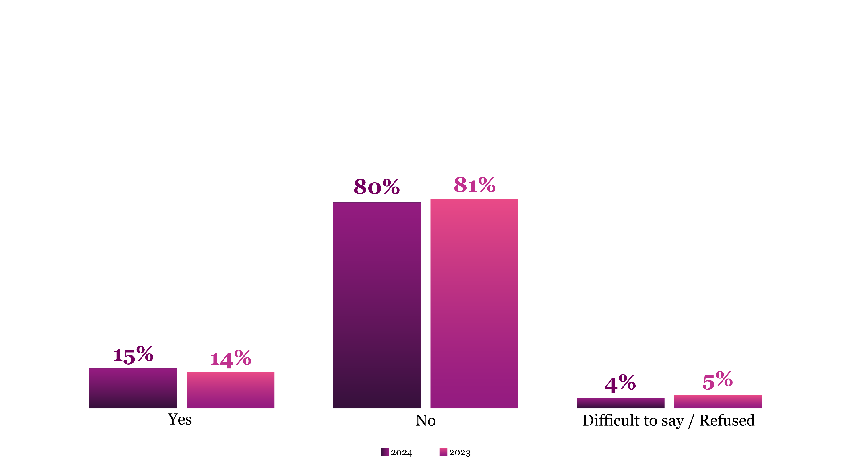
Q: In the past 12 months, have you or your family members been involved in any form of corruption with any governmental officials including educational, medical or other organizations?
Stabilization of Reported Corruption Encounters

Slide 10
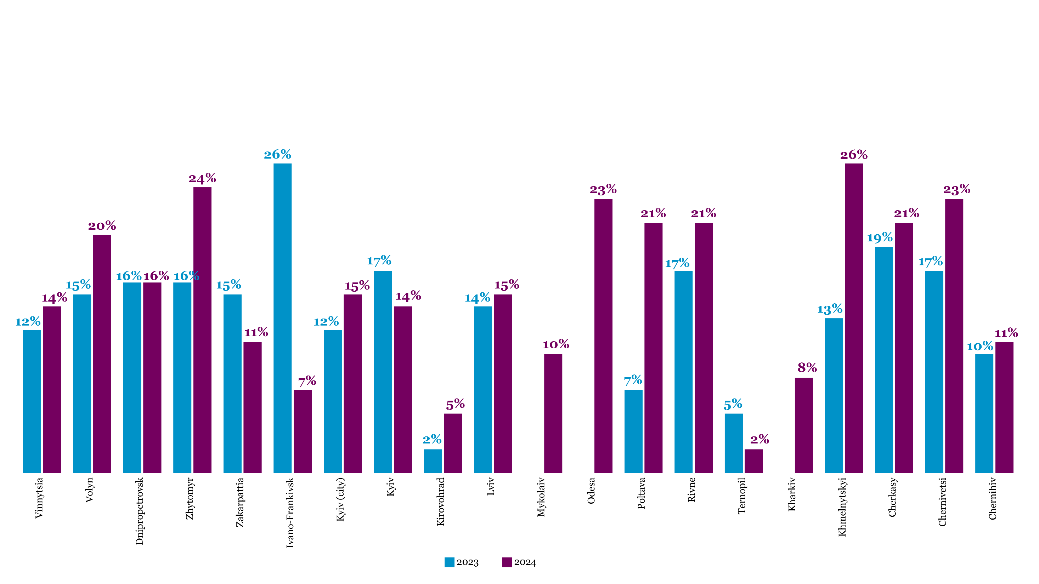
Reported Corruption Decreases in Ivano-Frankivsk, Kyiv, and Ternopil Oblasts, While Rising in Other Regions
Q: In the past 12 months, have you or your family members been involved in any form of corruption with any governmental officials including educational, medical or other organizations (i.e. you have been extorted (openly or not) or you have voluntarily offered unofficial payment in the form of money, gifts, protection, or services)?

Slide 11
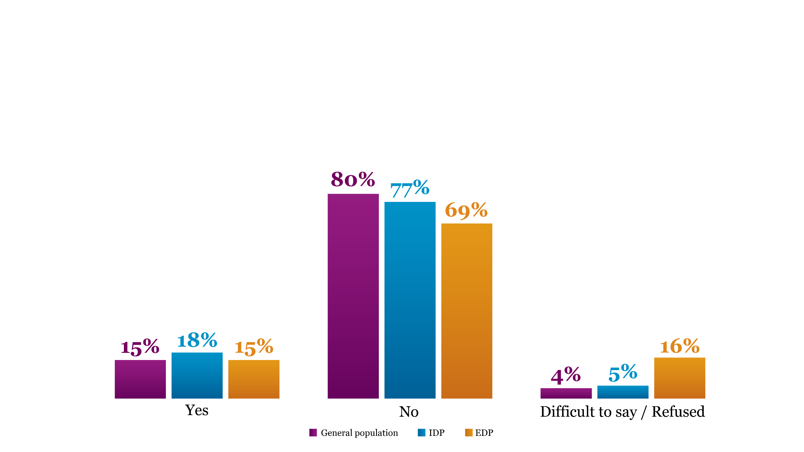
IDPs Face Corruption More Frequently
Q: In the past 12 months, have you or your family members been involved in any form of corruption with any governmental officials including educational, medical or other organizations?

Slide 12
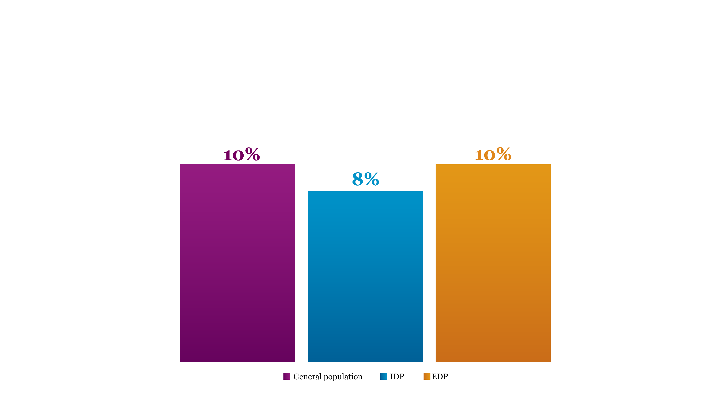
Q: Have you filed a complaint with the government or a law enforcement agency related to a corruption case? Affirmative responses
Low Reporting Rates on Corruption Persist, with EDPs Leading in Complaints

Slide 13

Q. What is the main reason you did not complain about a corruption case?
Majority of Citizens See Reporting Corruption as Futile
63%
though it would be in vain

Slide 14
Trust, Attitudes and Responsibilities

Slide 15
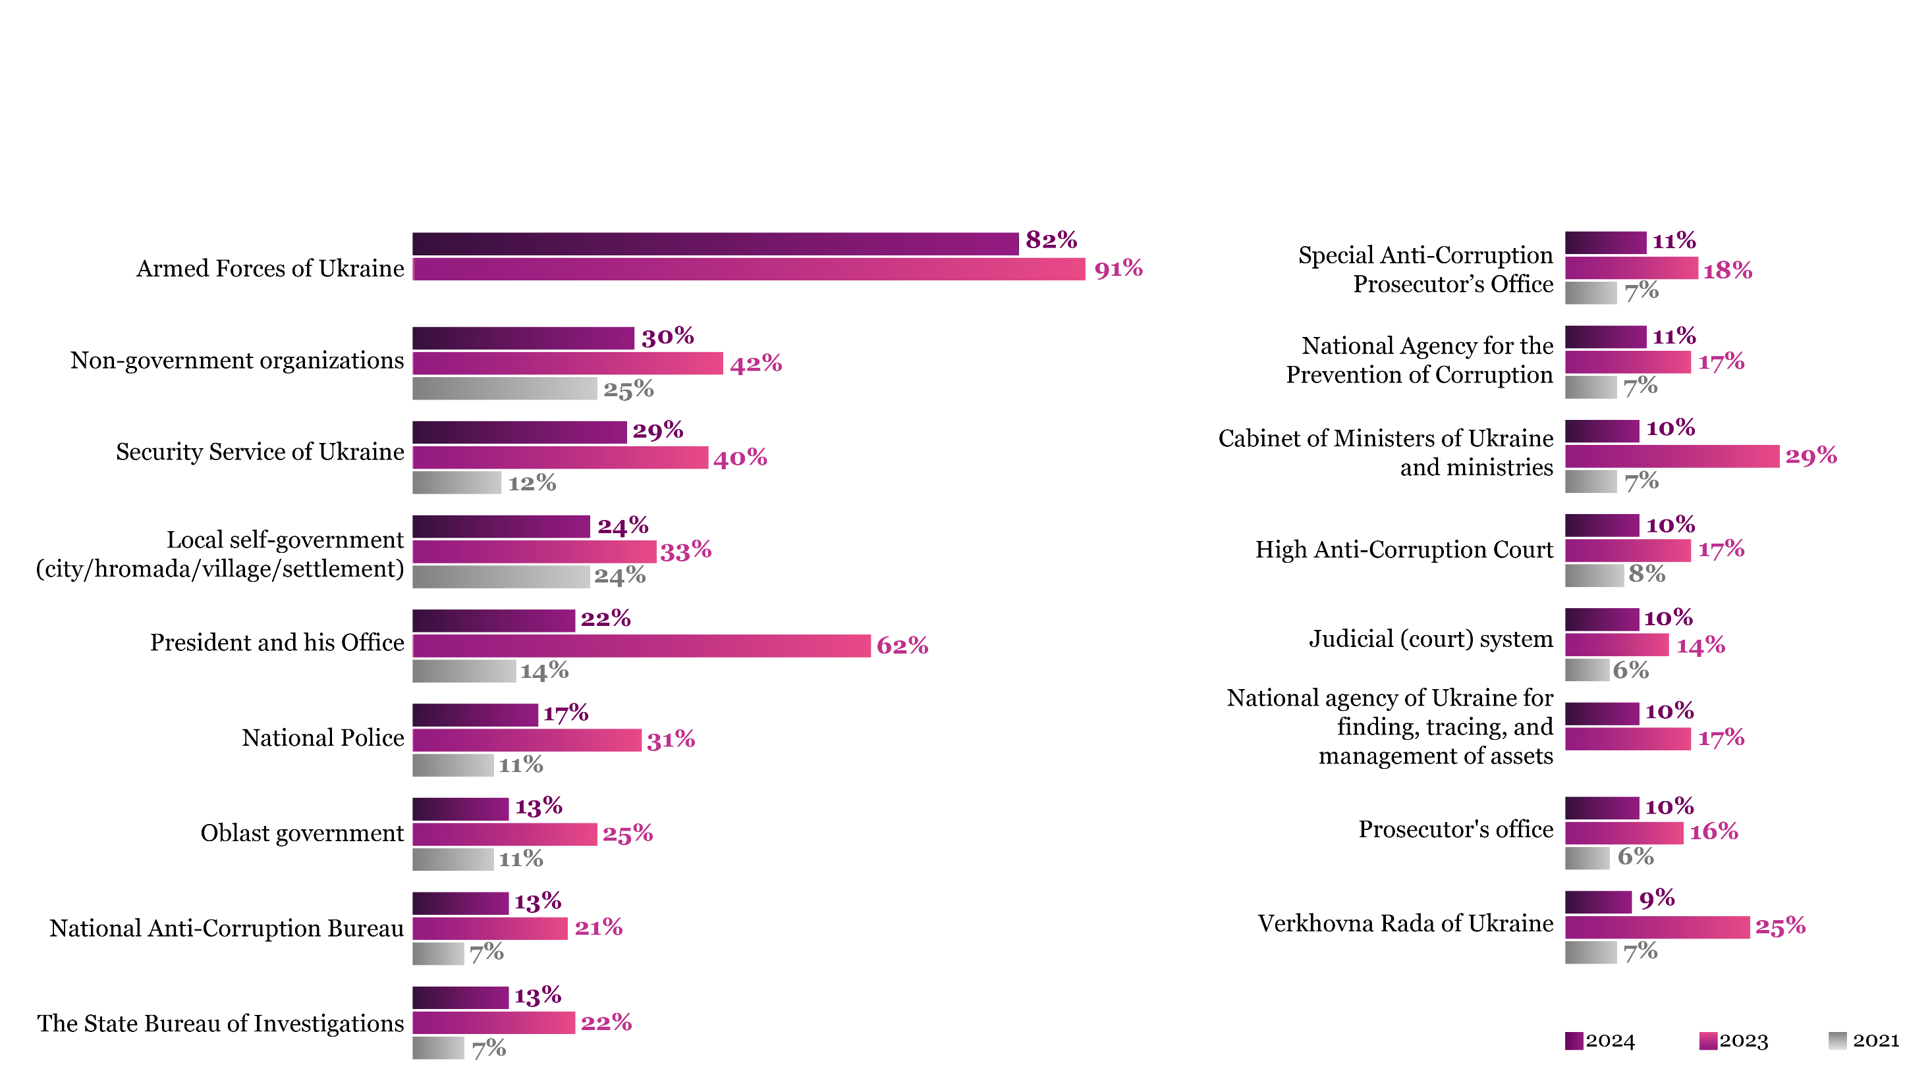
Q. To what extent do you trust government bodies and branches? (sum of responses “completely trust” and “rather trust”)
Except for the Armed Forces, Trust in Government Bodies Declines Significantly

Slide 16
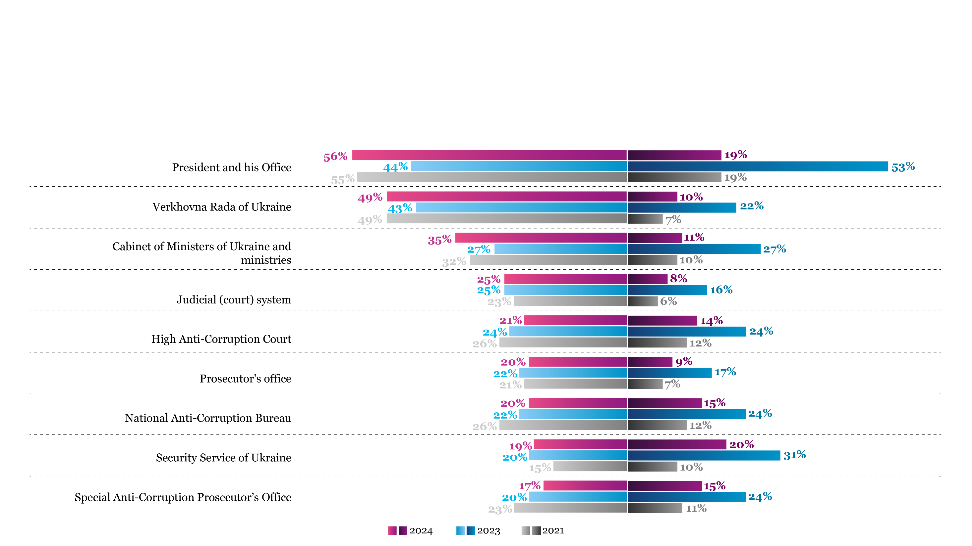
Security Service Leads in Willingness to Tackle Corruption
Q. In your opinion, who is responsible for overcoming corruption in Ukraine?
Q. Do you think [name the body] is willing to overcome corruption in Ukraine?

Slide 17
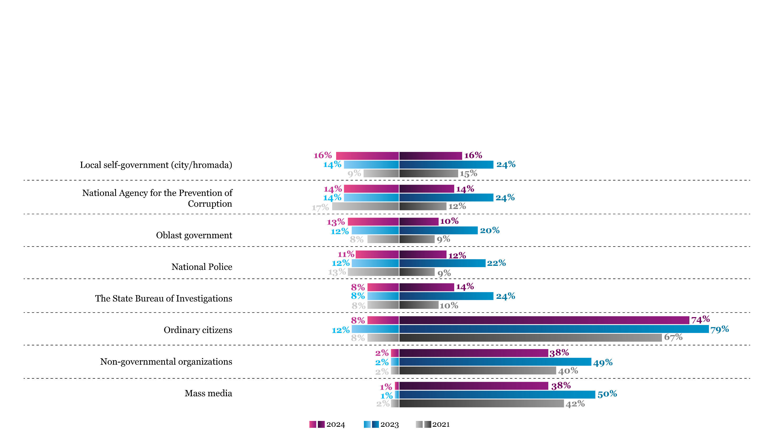
CSOs and Media Retain Key Role in Anti-Corruption Efforts
Q. In your opinion, who is responsible for overcoming corruption in Ukraine?
Q. Do you think [name the body] is willing to overcome corruption in Ukraine?

Slide 18
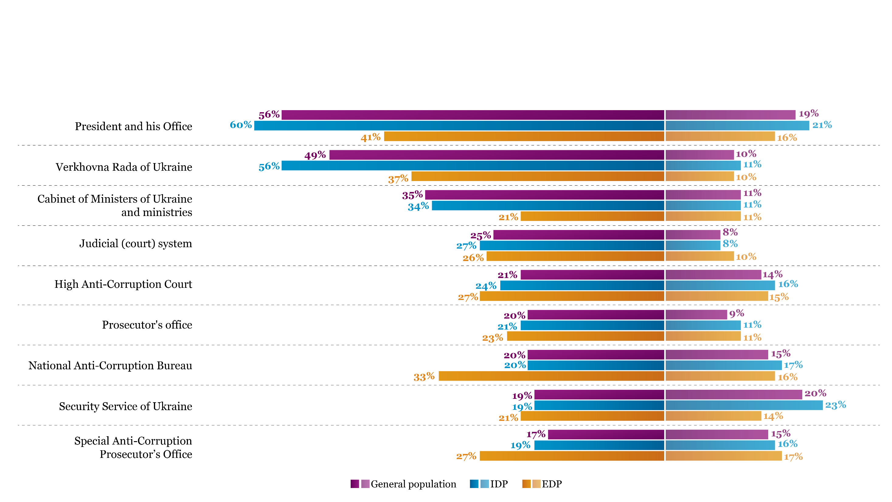
EDPs Display Reduced Expectations for Government's Role in Tackling Corruption
Q. In your opinion, who is responsible for overcoming corruption in Ukraine?
Q. Do you think [Name the body] is willing to overcome corruption in Ukraine?

Slide 19
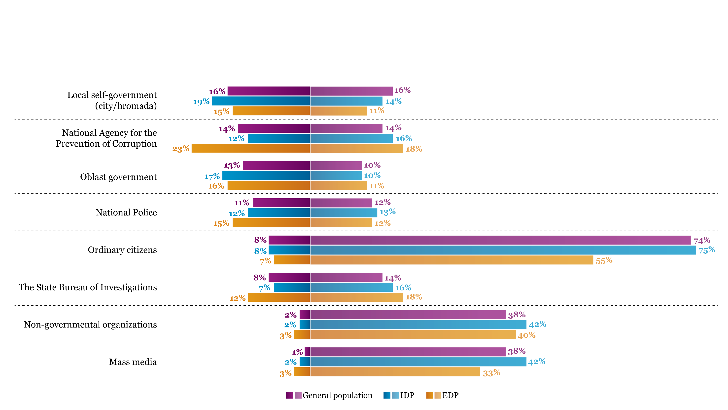
EDPs Attribute Greater Responsibility for Anti-Corruption Efforts to Specialized Agencies
Q. In your opinion, who is responsible for overcoming corruption in Ukraine?
Q. Do you think [Name the body] is willing to overcome corruption in Ukraine?

Slide 20
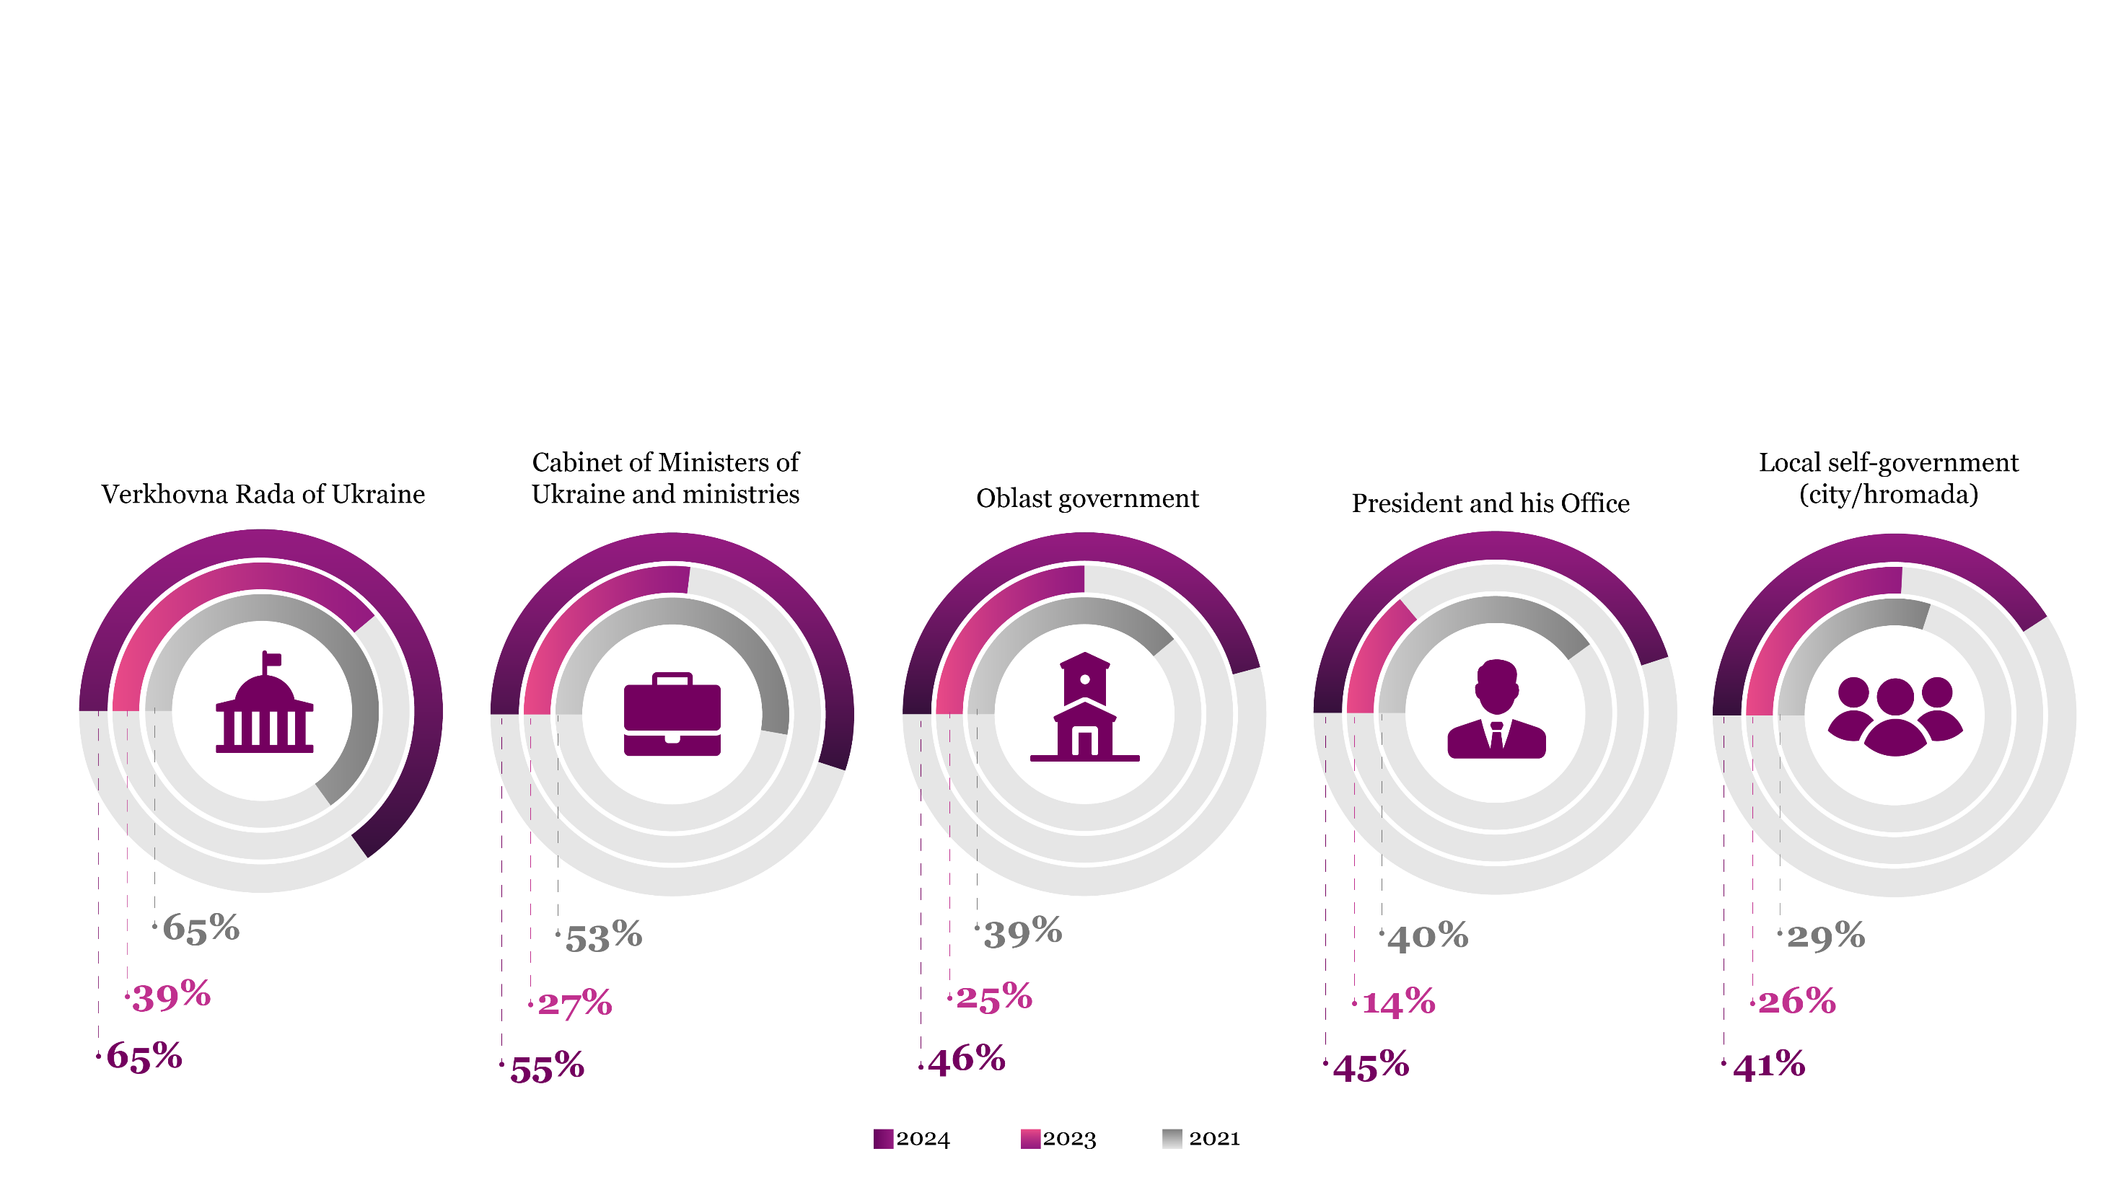
Q: In your opinion, how widespread is corruption?
Perceptions of Corruption in Government Branches Increase

Slide 21
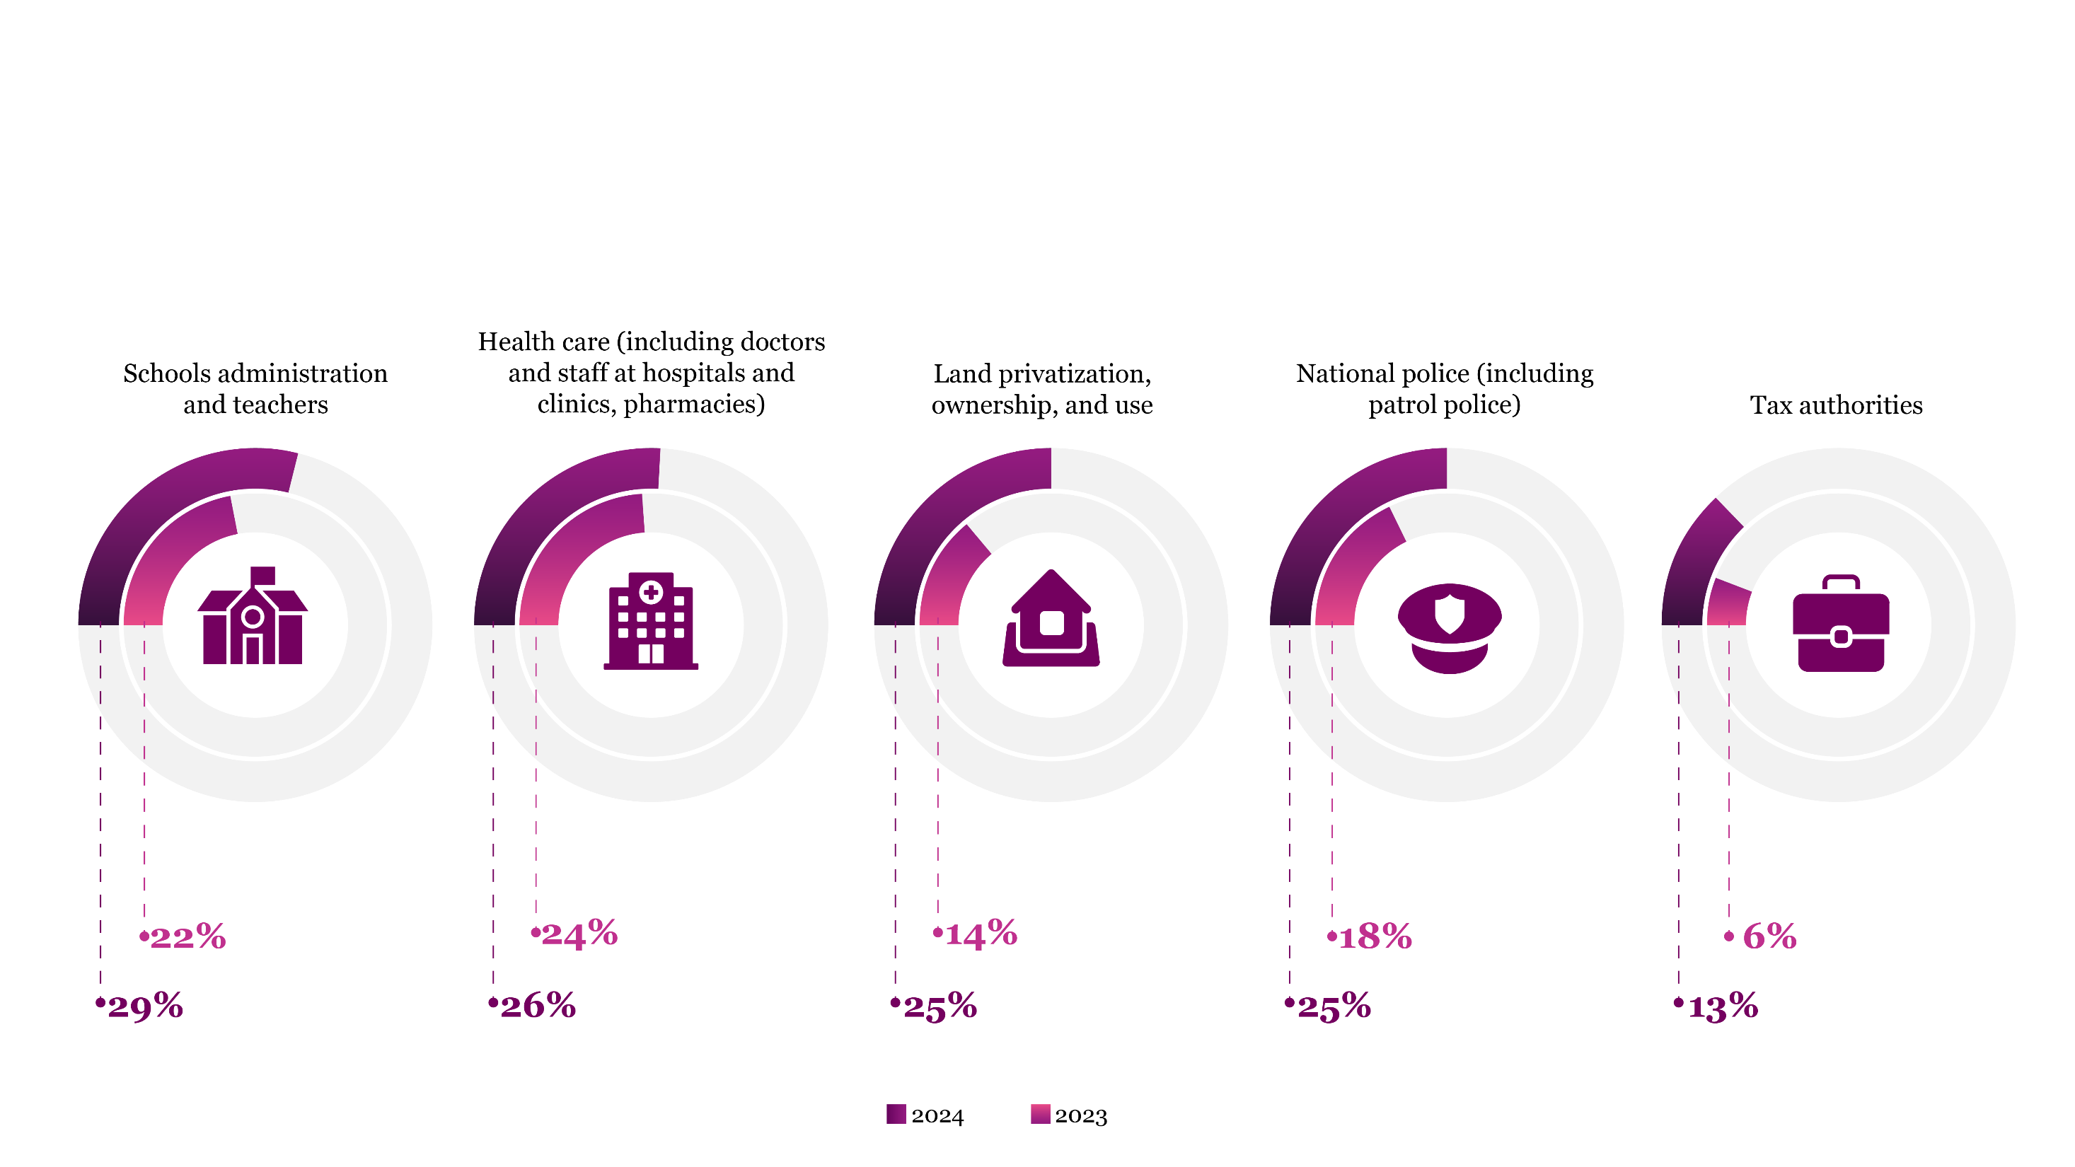
CUSTOMS AND THE JUDICIAL SYSTEM ARE LEADERS BY SPREAD OF CORRUPTION IN PEOPLE’S PERCEPTION
Increasing Instances of Corruption in Critical Sectors
Q: Was a bribe (in the form of a gift, favor, service or money) requested from you or your family member? (% of those who dealt with government authorities or state institutions over the past 12 months):

Slide 22
Awareness of Anticorruption Efforts

Slide 23
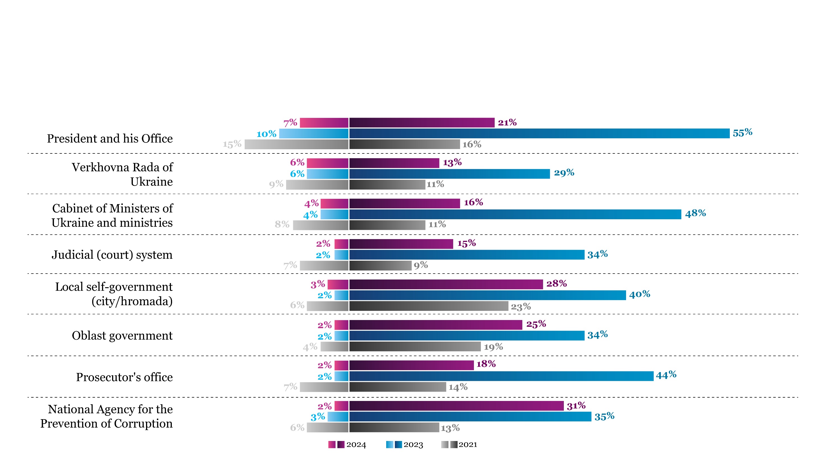
Awareness of Anti-Corruption Efforts Remains Stable, but Confidence in Government Effectiveness Declines
Q. Are you aware of any anti-corruption activities implemented over the past 12 months by any of the following entities?
Q. How effective are they?

Slide 24
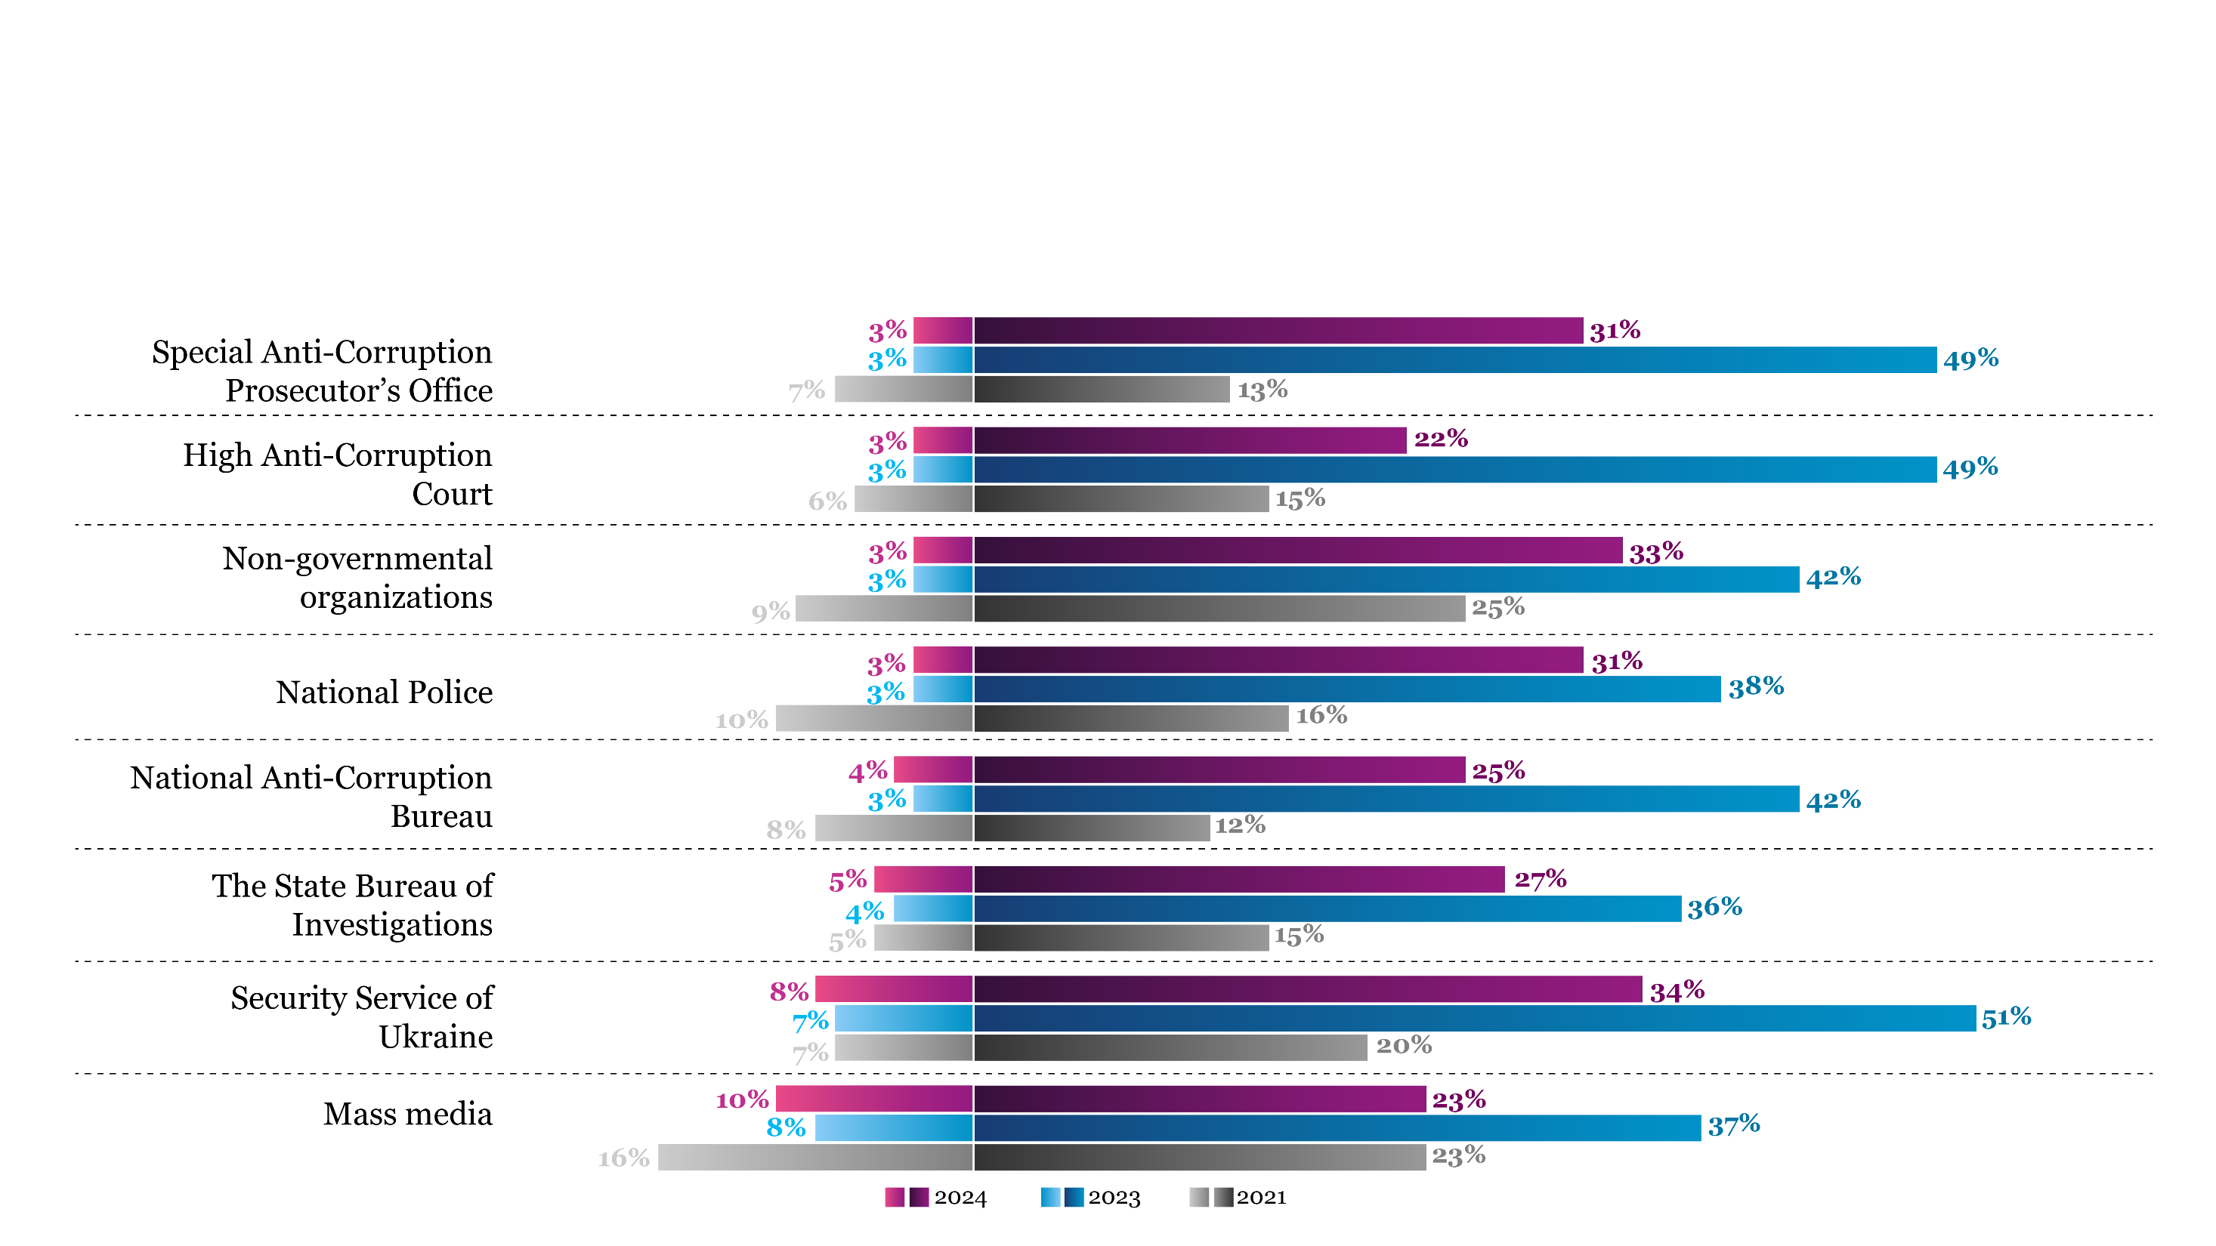
Security Service Still Leads in Perceived Anti-Corruption Effectiveness
Q. Are you aware of any anti-corruption activities implemented over the past 12 months by any of the following entities?
Q. How effective are they?

Slide 25
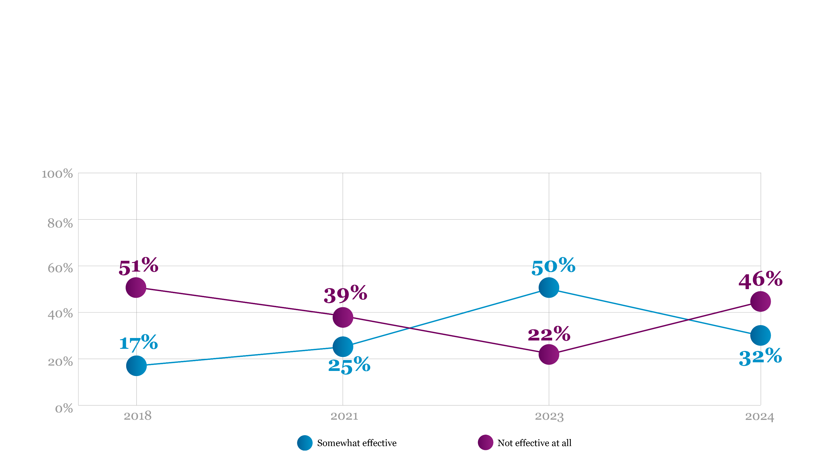
Q: In your opinion, to what extent is the government of Ukraine effective in fighting corruption?
Public Pessimism on Government's Anti-Corruption Efforts Approaches 2018 Levels

Slide 26
Citizens against Corruption

Slide 27
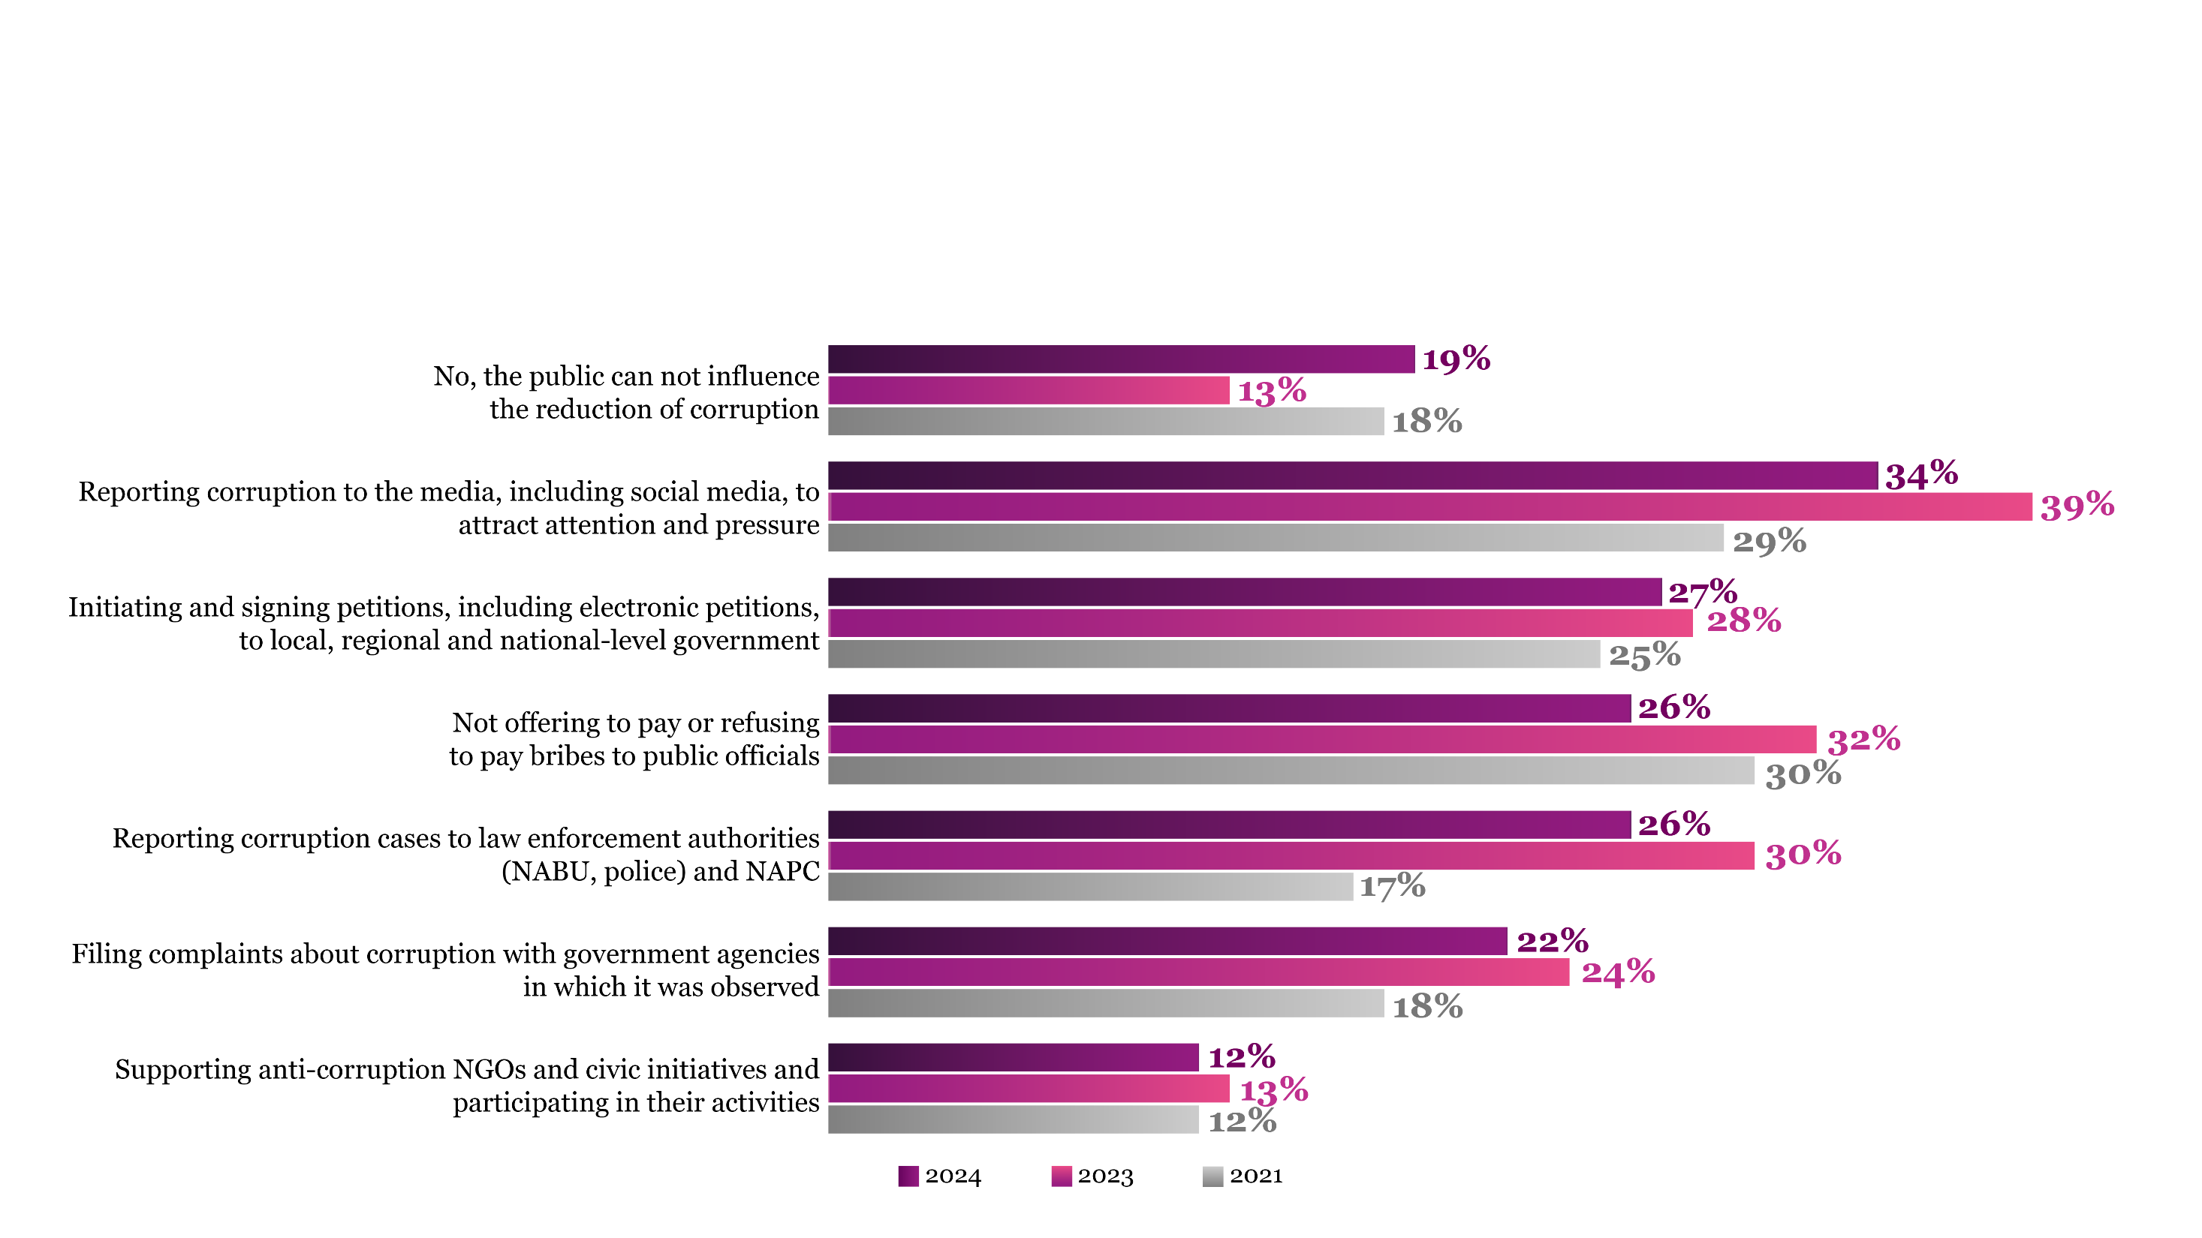
Public Confidence in Anti-Corruption Interventions Declines
Q: In your opinion, can the public influence the reduction of corruption by doing the following?

Slide 28
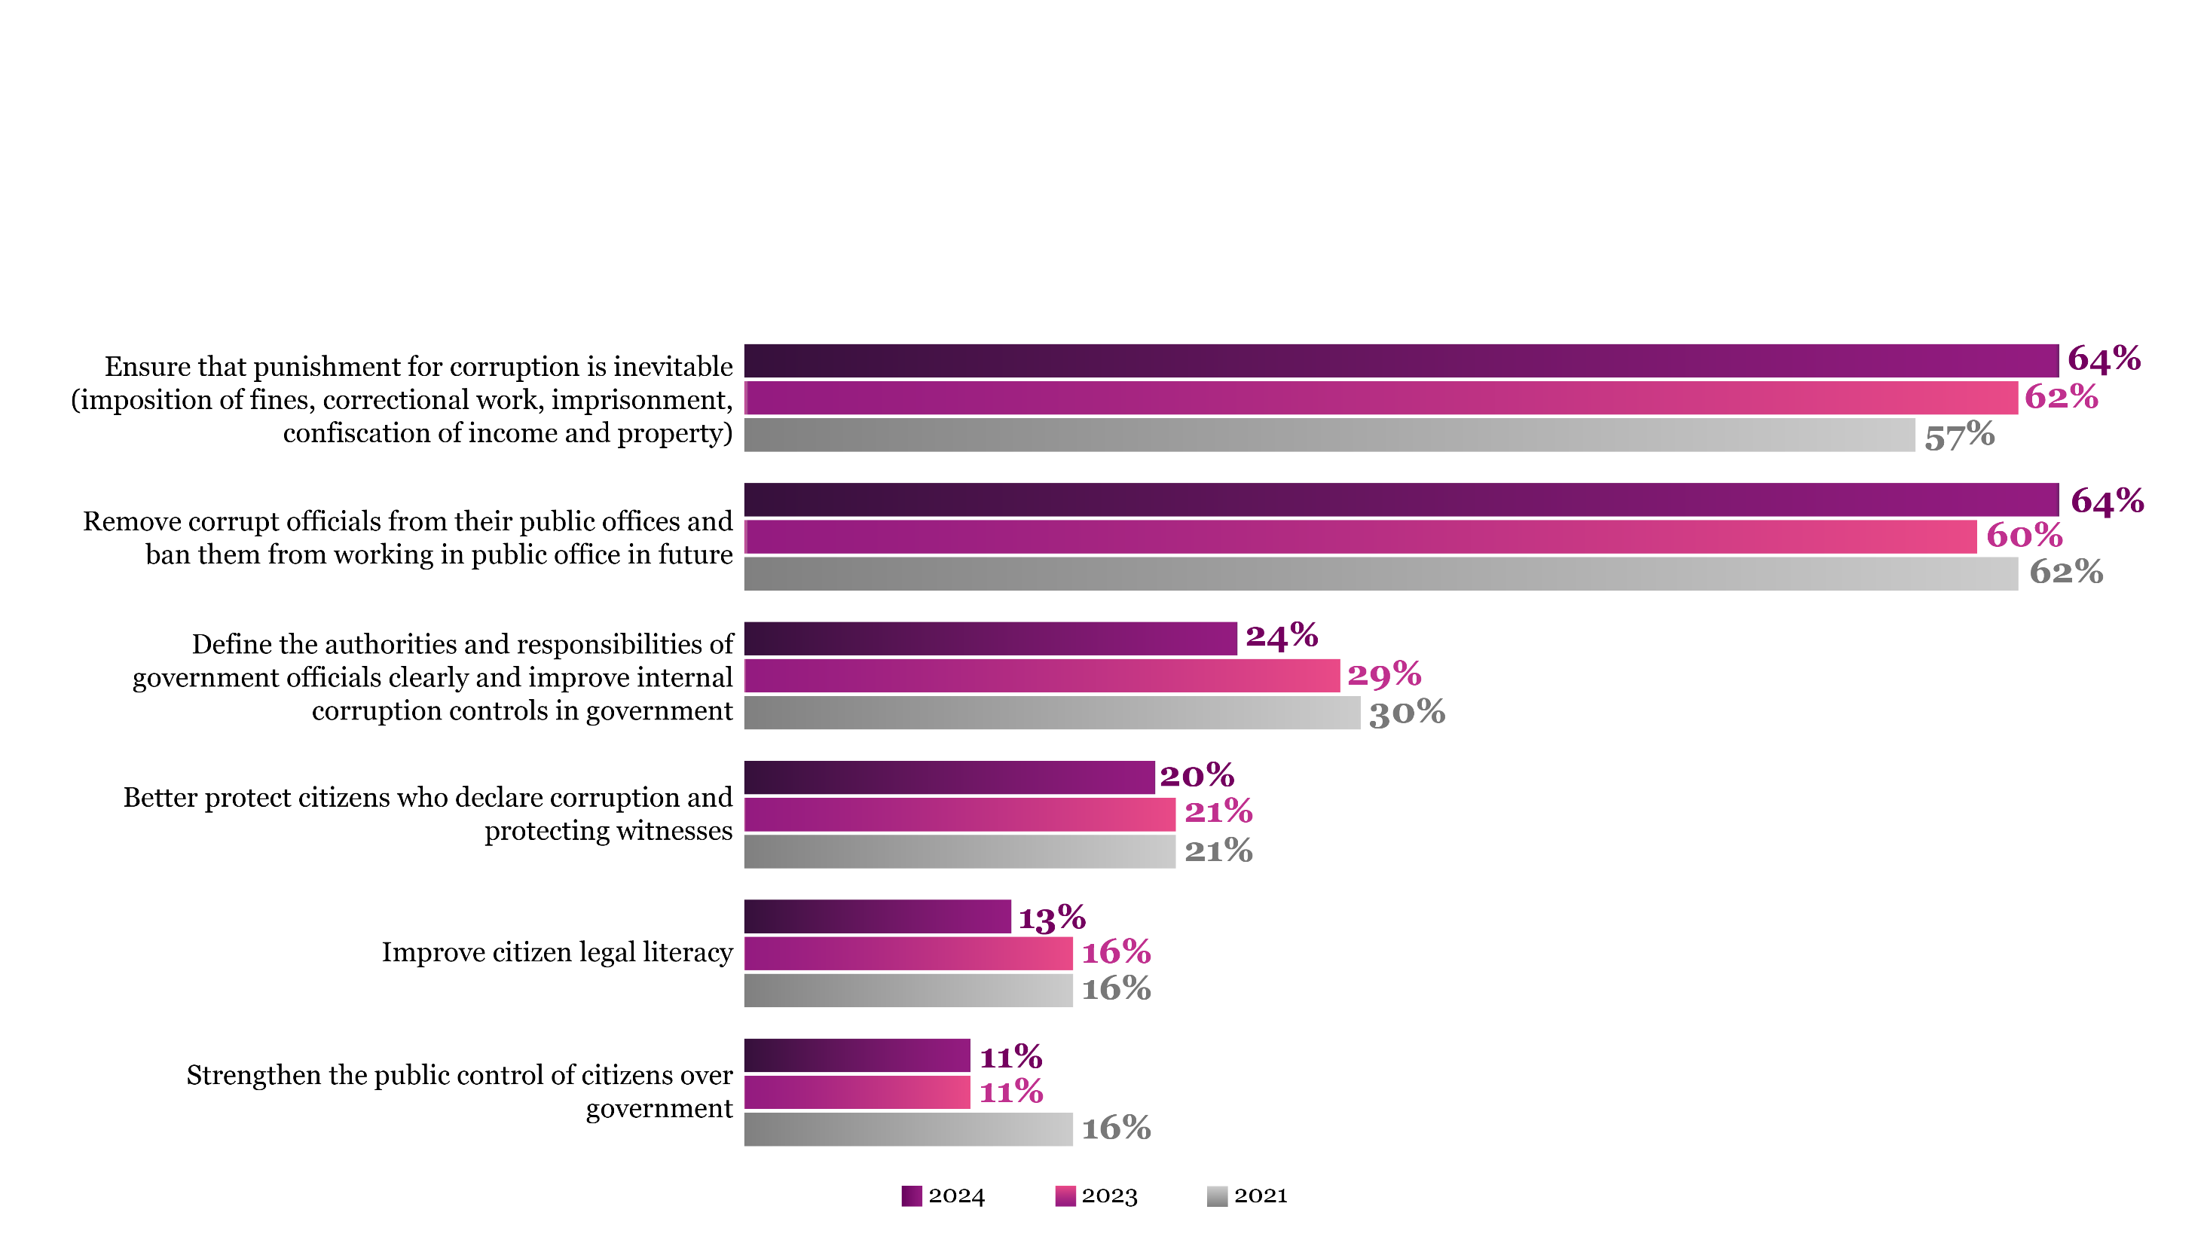
Public Perception of Effective Anti-Corruption Measures Shifts
Q: In your opinion, which of the following measures are the most effective in fighting and preventing corruption? Choose three, starting with the most effective measure

Slide 29
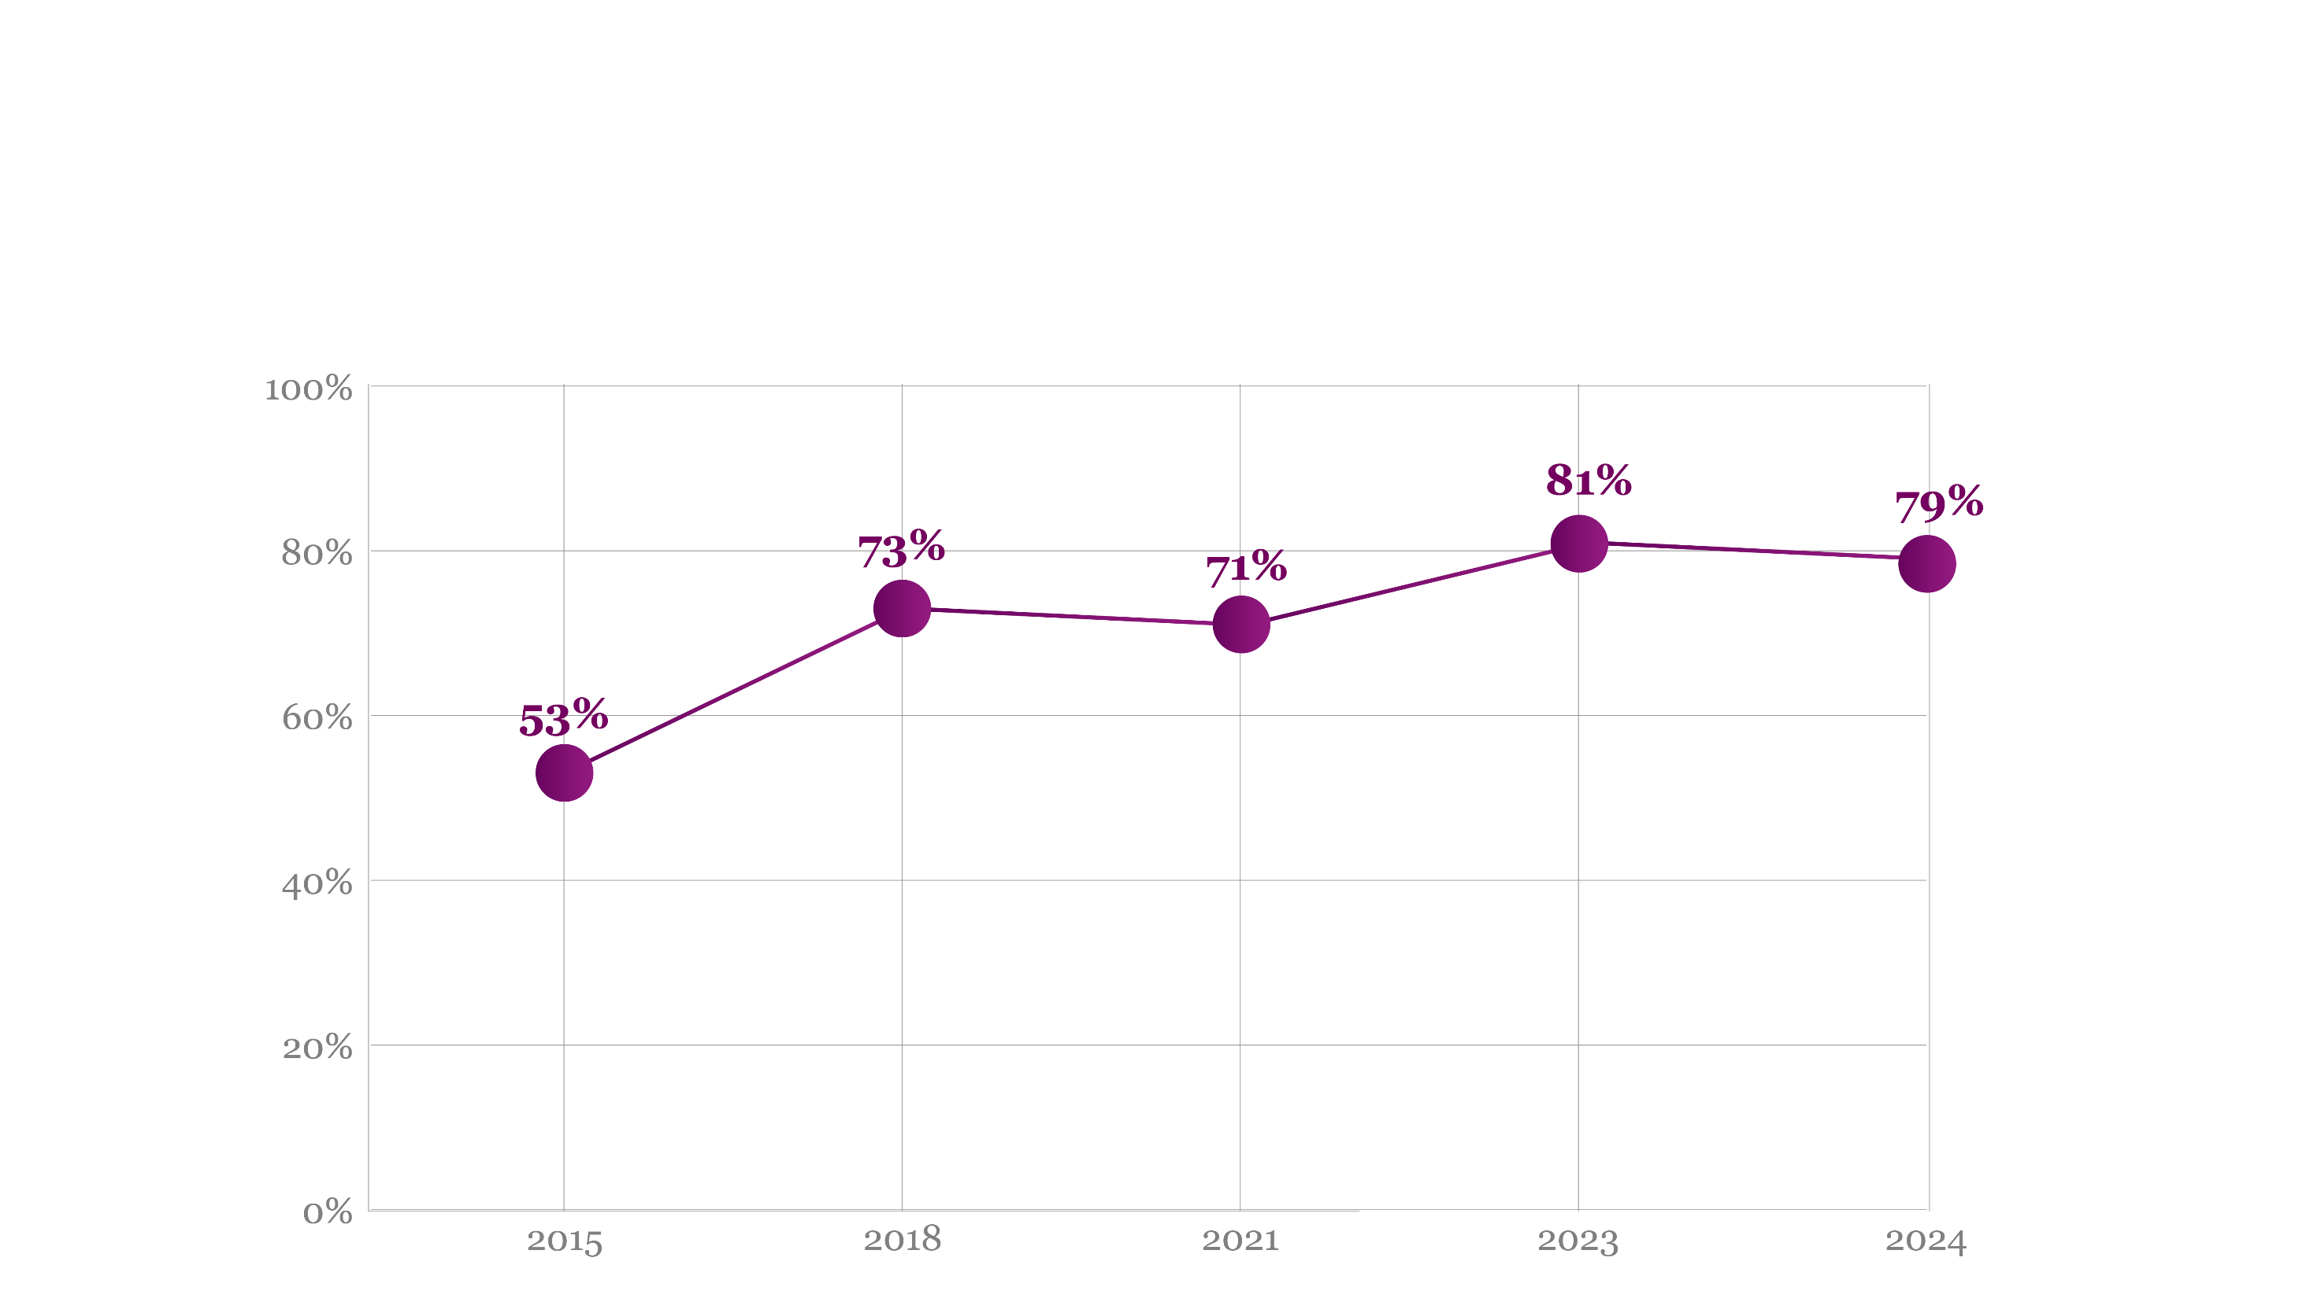
Public Approval of Whistleblowing Remains Strong
Q: What is your attitude towards individuals who file complaints with the government or law enforcement agencies regarding a corruption case?
(sum of responses “rather approval” and “total approval”)

Slide 30
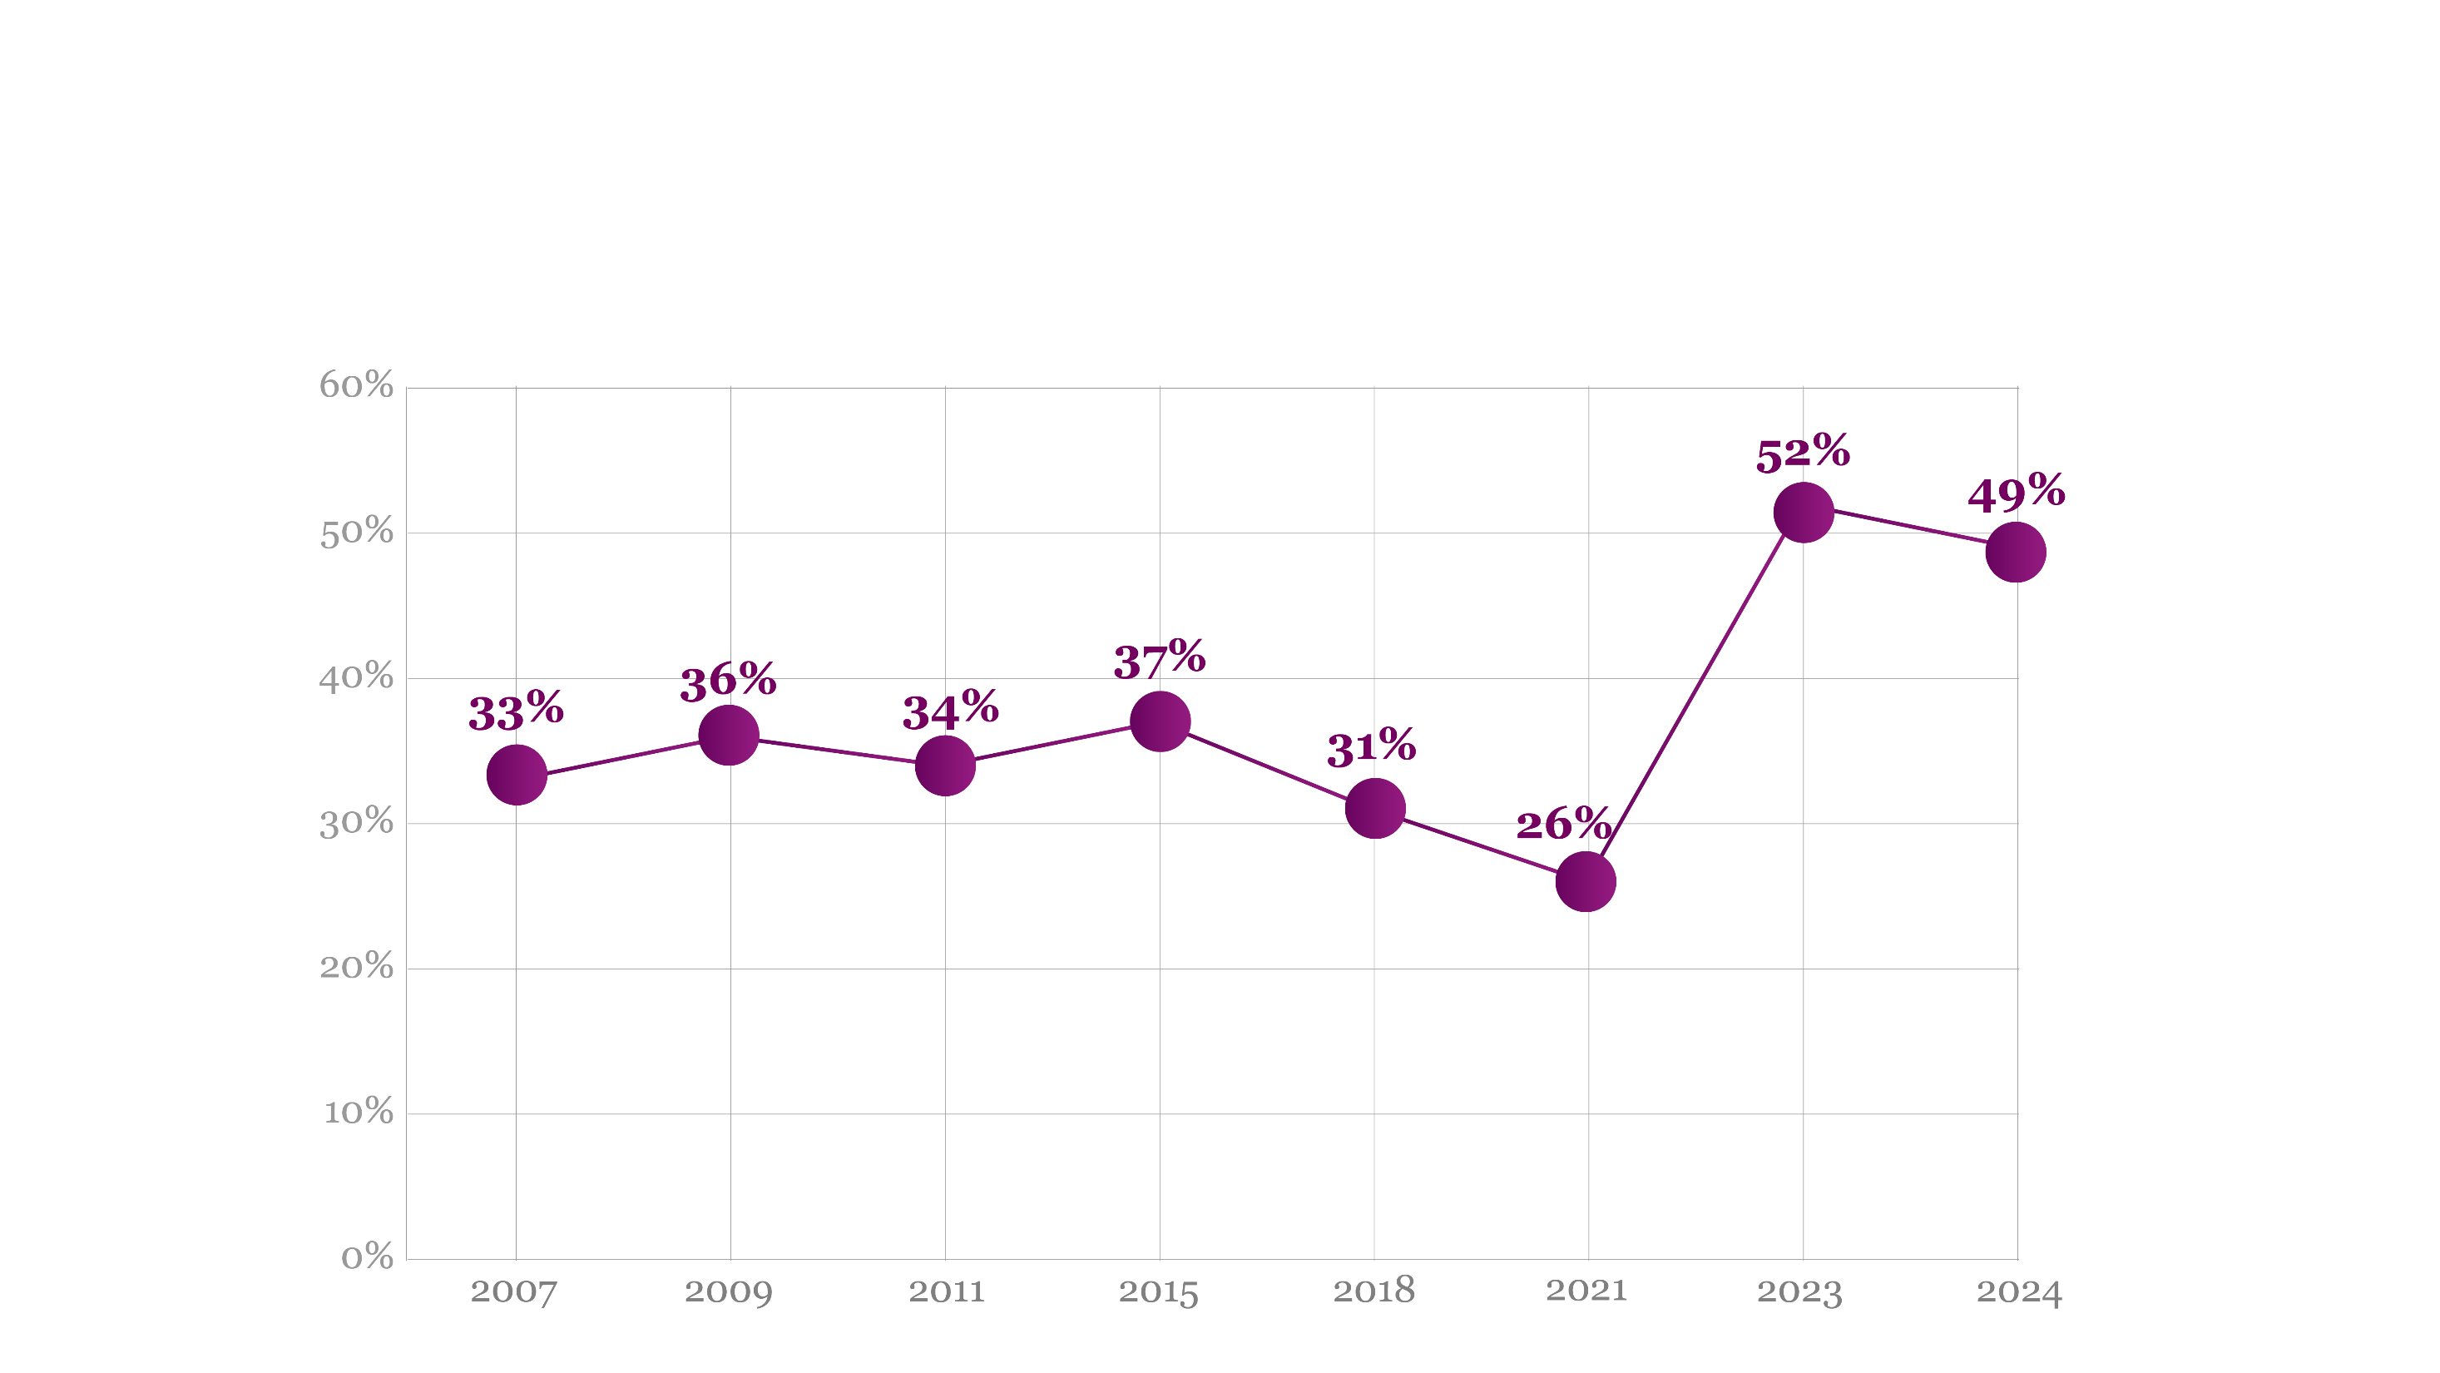
Citizens’ Readiness to Stand Up for Their Rights Rebounds to Higher Levels
Q: How ready are you to stand up for your rights when you interact with bureaucrats?
Notes:
Слайд 22

Slide 31
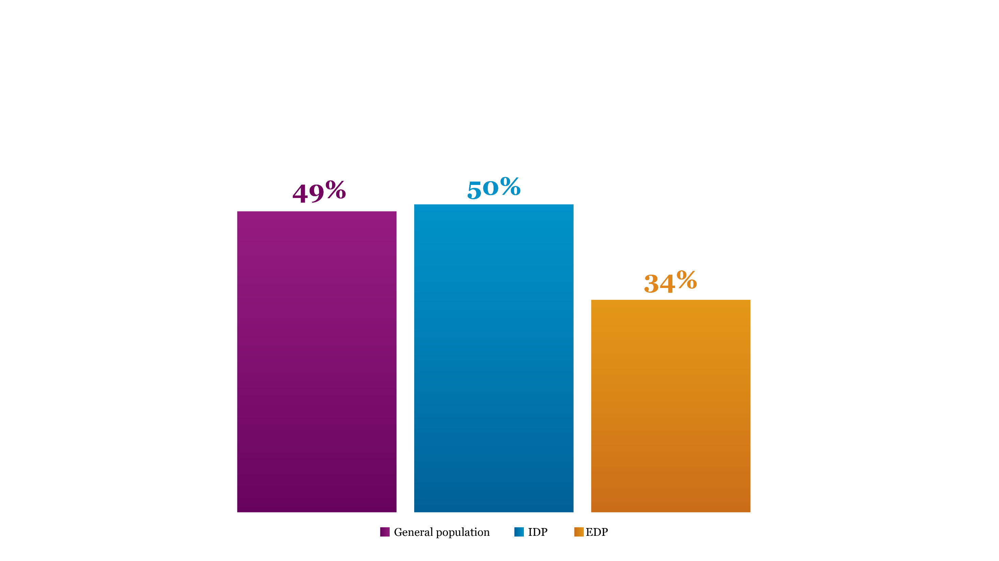
EDPs Are the Least Ready to Confront Officials
Q: How ready are you to stand up for your rights when you interact with bureaucrats?

Slide 32
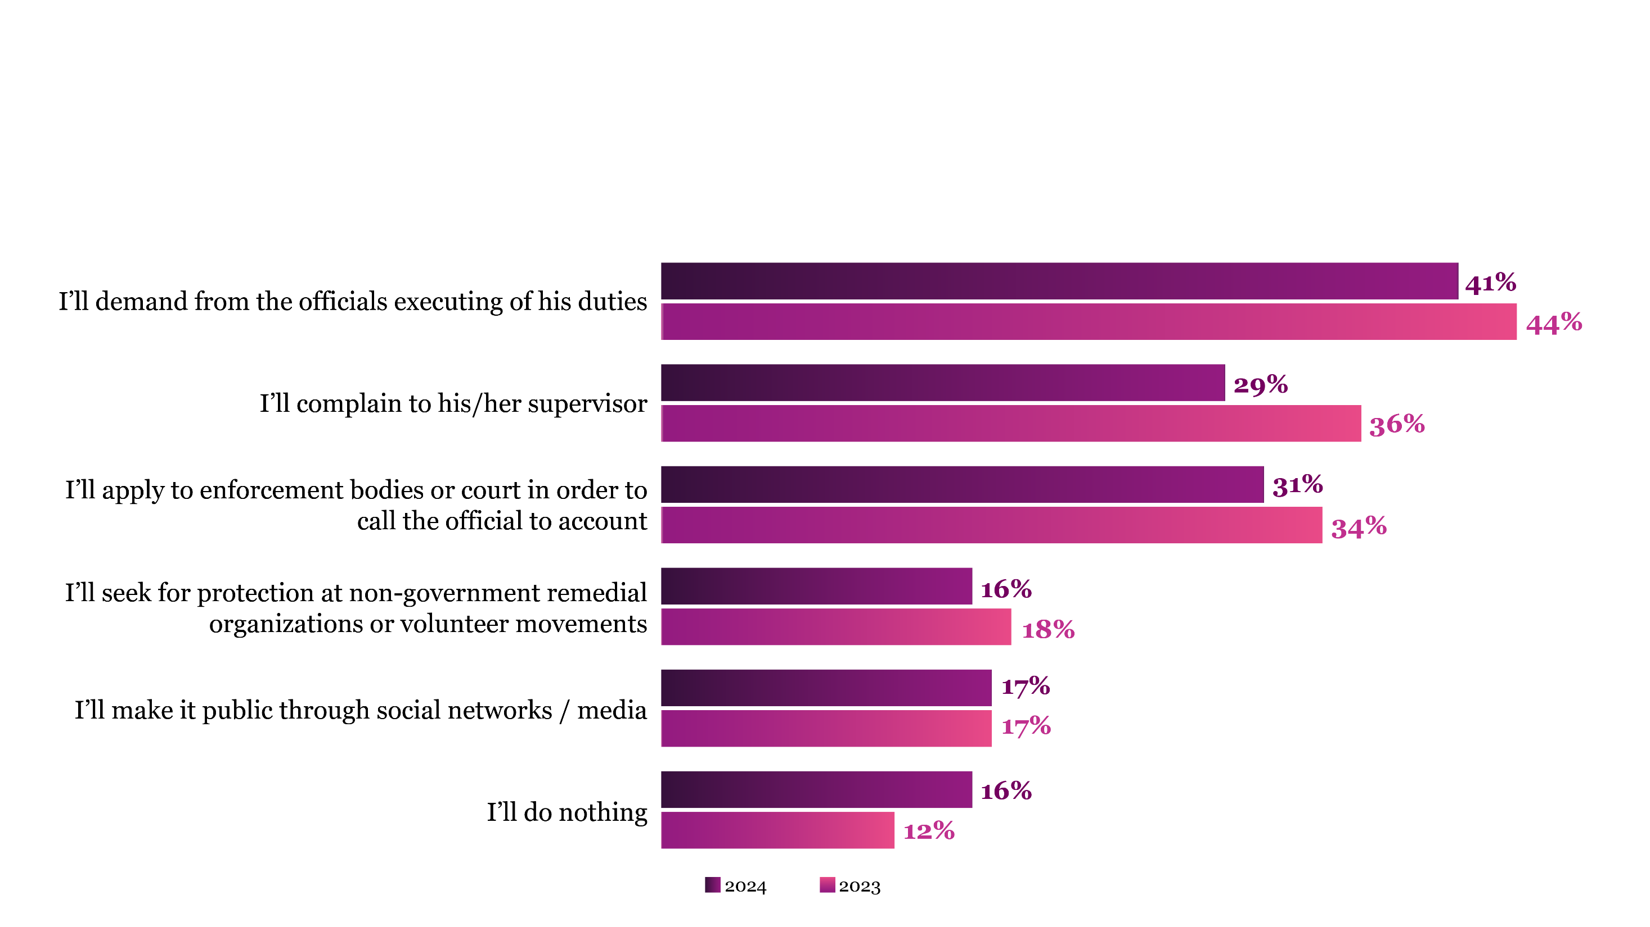
Readiness to Undertake Measures Against Corrupt Officials Has Decreased
Q: In what way are you ready to act when a state official violates your rights?

Slide 33
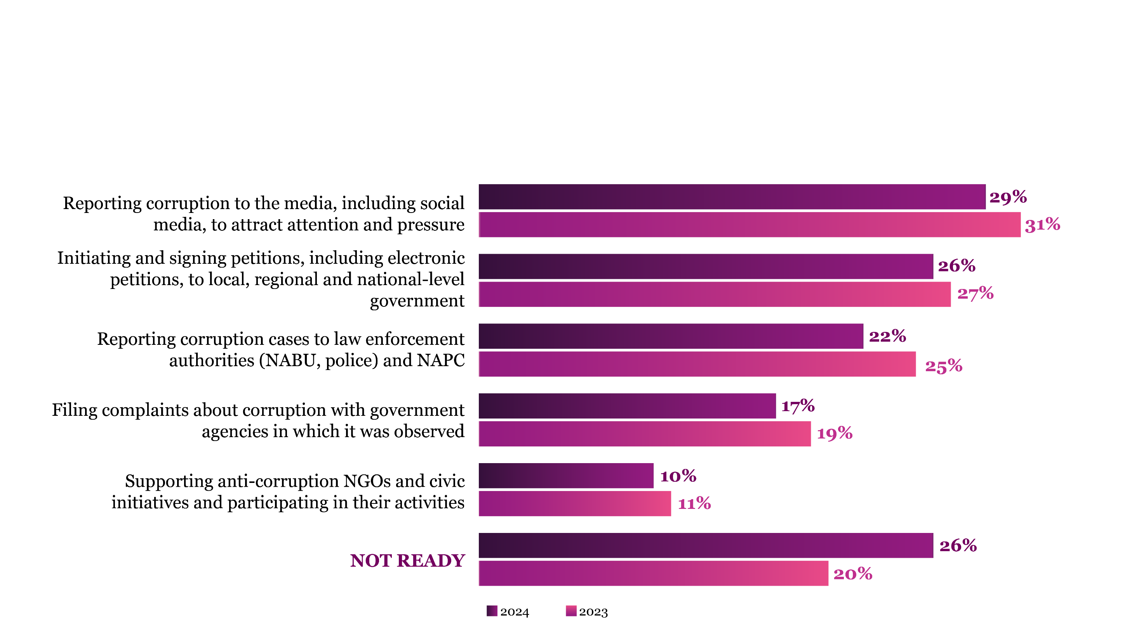
Growing Pessimism: More Citizens Reluctant to Engage in Anti-Corruption Efforts
Q: Are you ready to participate in the following activities?

Slide 34
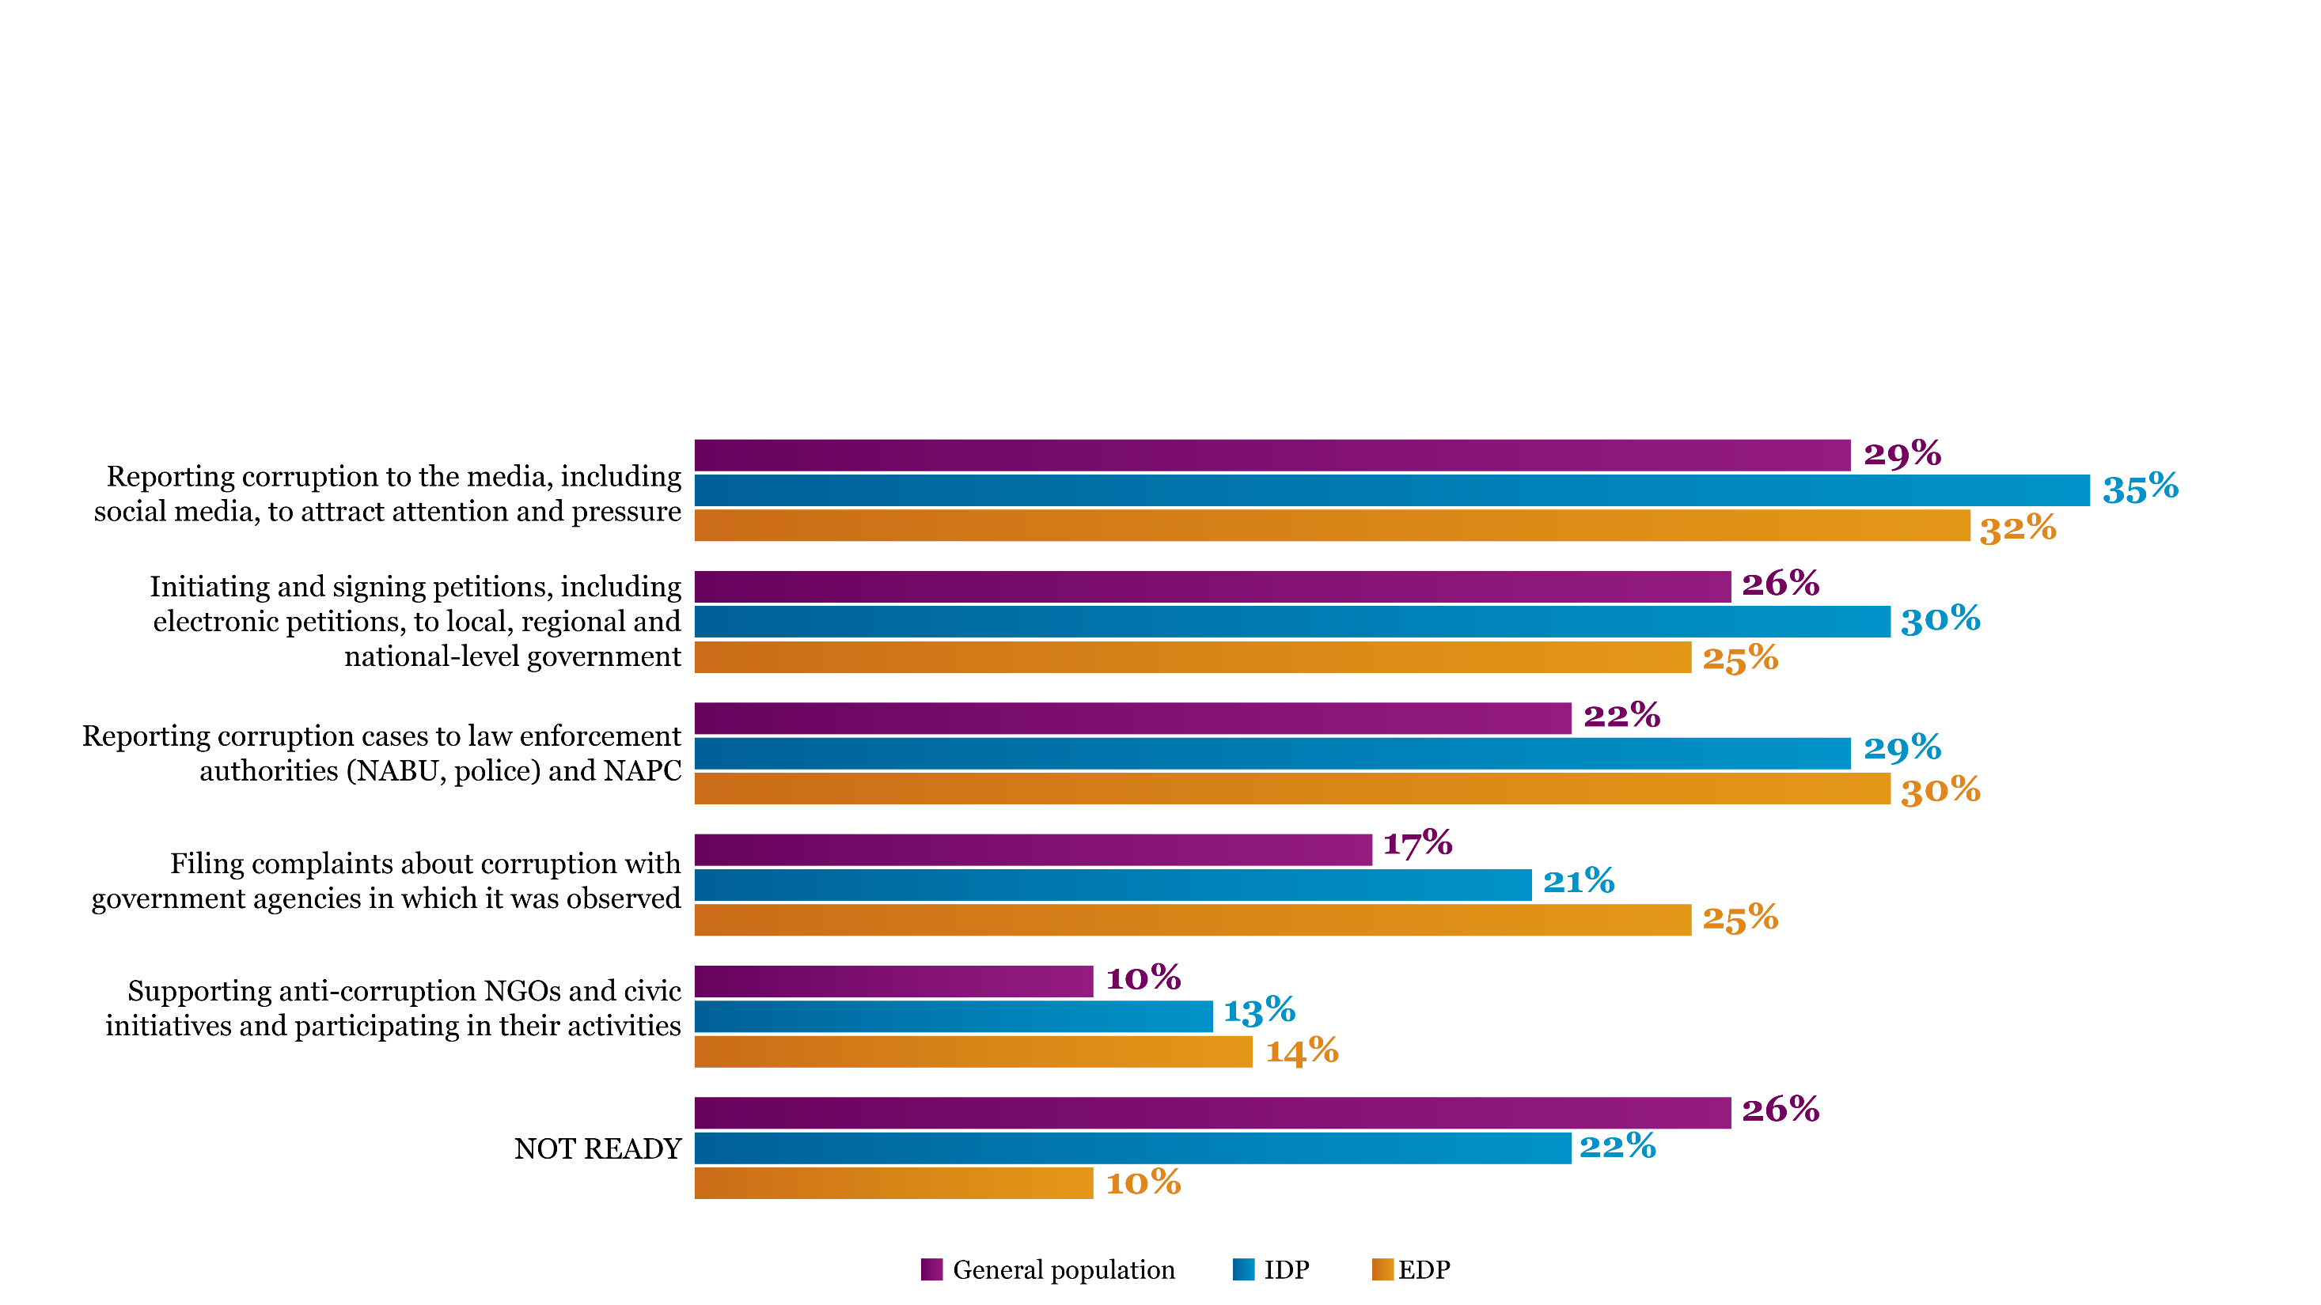
Displaced Ukrainians Show Stronger Willingness for Anti-Corruption Engagement than General Population
Q: Are you ready to participate in the following activities?

Slide 35
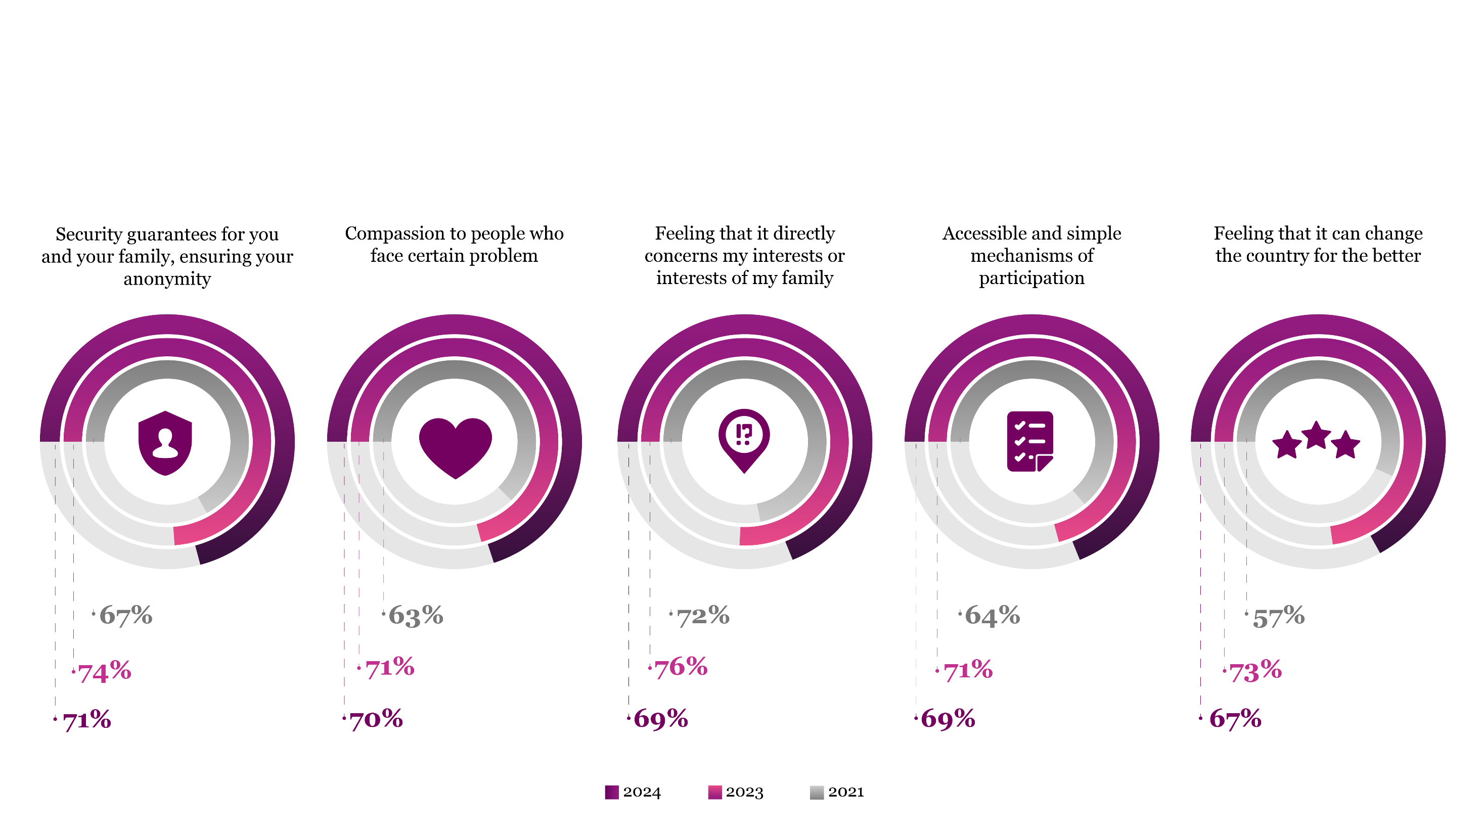
Personal and Family Interests Drive Civic Engagement in Anti-Corruption Efforts
Q: What can motivate you to engage in anticorruption activities?

Slide 36
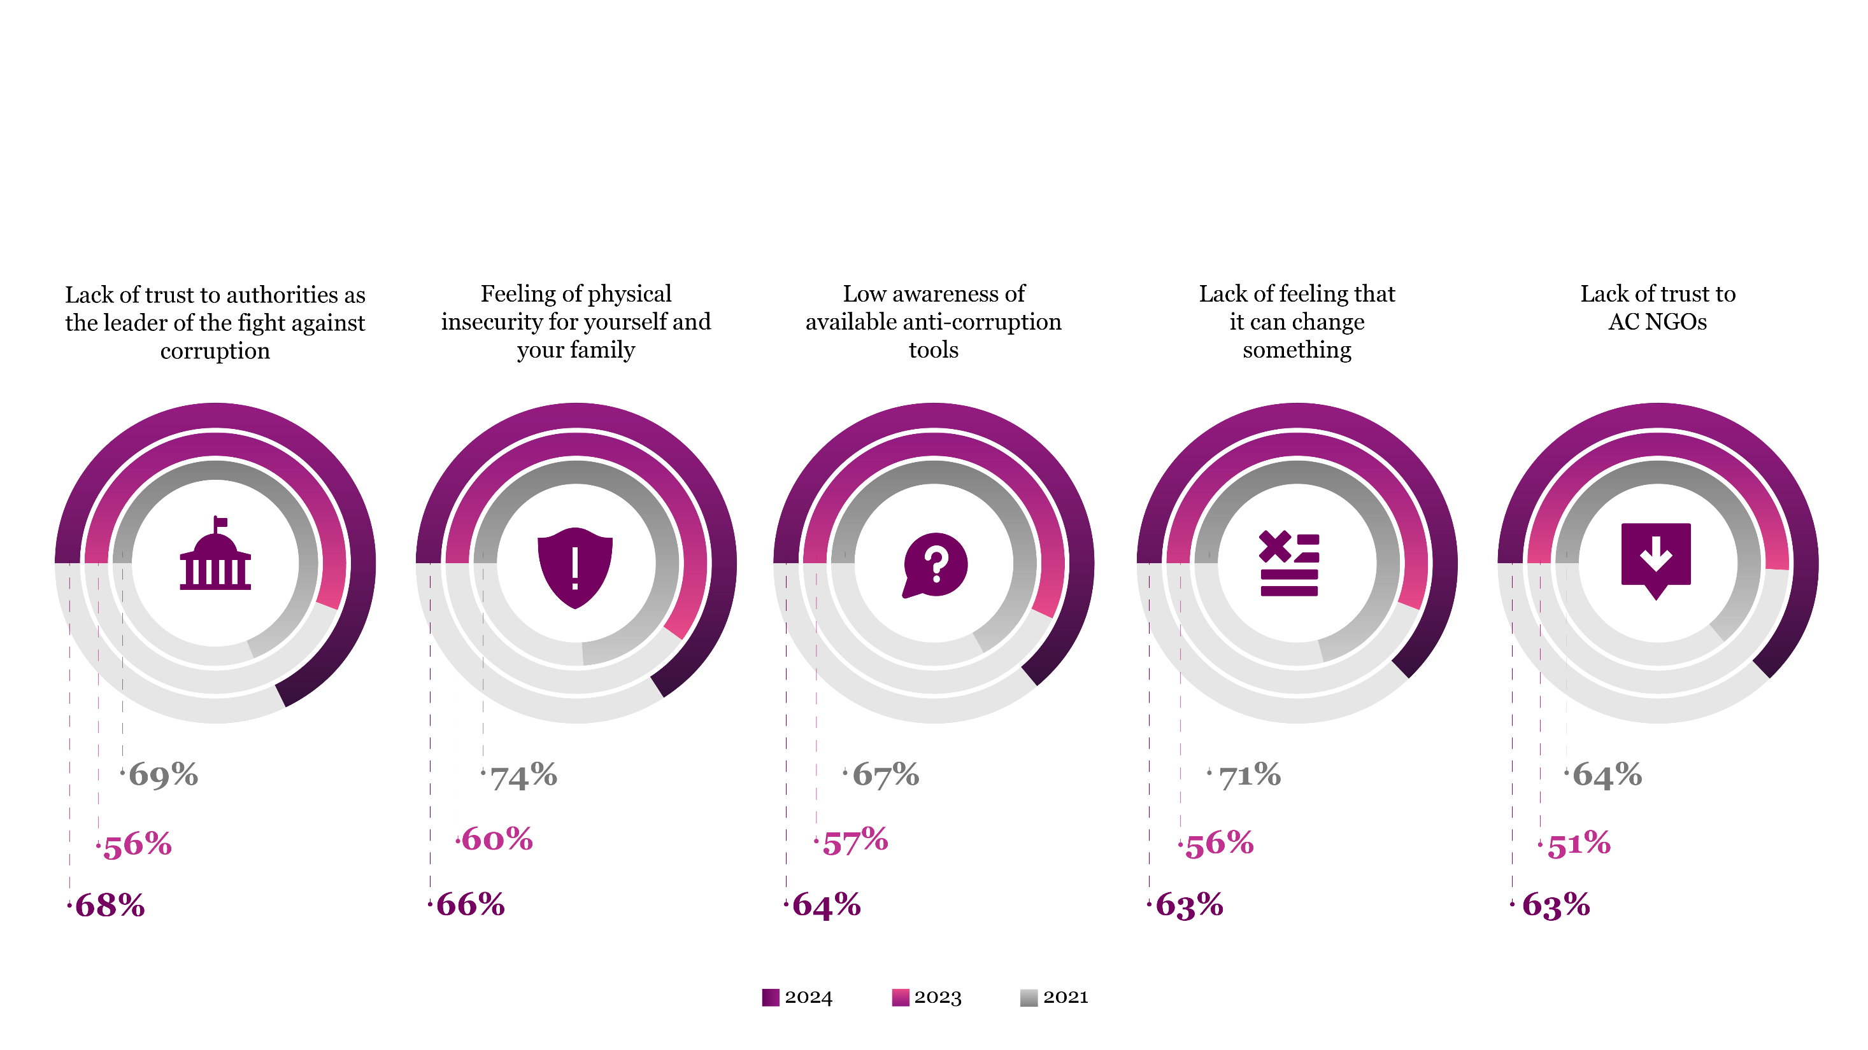
Trust and Security Concerns Remain Key Barriers to Civic Anti-Corruption Engagement
Q: What can discourage you from engaging in anticorruption activities?

Slide 37
METHODOLOGY: GENERAL POPULATION
Polling agency: Kyiv International Institute of Sociology
Population: adults (≥18y.o.) from all oblasts of Ukraine and Kyiv city *
Survey method: face-to-face interview
Sampling: multistage random sample with quota selection at the last stage
Margin of error: ≤ 1.5%
 | 2007 | 2009 | 2011 | 2015 | 2018 | 2021
Fieldwork | Feb – Mar | Feb – Mar | Mar – Apr | Aug – Sep | Jul – Aug | Jan – Feb
Sample size | 10,580 | 10,577 | 10,639 | 10,173 | 10,169 | 10,011
2023
Dec - Feb
10,117
2024
Jun - Aug
10,121
Unique features:
Representative for each of 24 oblasts*, the city of Kyiv, and for the whole of Ukraine, in last round IDPs and Ukrainians residing abroad were also
Sample size allows to study corruption perception and experience in particular sectors
Comparable methodology allows to track changes from 2007 for most questions
* The temporarily occupied territories of the AR Crimea, city of Sevastopol, and certain areas of Donetsk and Luhansk oblasts which are outside the control of the government of Ukraine, were excluded from the 2015, 2018 and 2021 surveys.
In 2023 – population of AR Crimea, Donetsk, Zaporizhzhia, Luhansk, Mykolaiv, Odesa, Kharkiv, and Kherson oblasts;
In 2024 – population of AR Crimea, Donetsk, Zaporizhzhia, Luhansk, and Kherson oblasts.

Slide 38
METHODOLOGY: INTERNALLY AND EXTERNALLY DISPLACED
Target group | Internally displaced persons (IDPs) | Externally displaced persons (EDPs)
Sample size | 1 000 | 2 000
Geographic coverage | 20 oblasts of Ukraine | 42 countries around the world
Survey method | Face-to-face interview | Online self-administered interview; Interviews via messengers
Sampling | Random walk approach; Time-location sampling | Snow-ball technique

